Slide 1
Lecture 08 - Convolutional neural networks
SIN 393 – Introduction to Computer Vision (2022-2)
Prof. João Fernando Mari
joaofmari.github.io
joaof.mari@ufv.br

Slide 2
Agenda
Classification pipelines
Multilayer perceptron (MLP)
Convolutional neural networks (CNNs)
Convolutional layer
Pooling layer
Activation layer
Fully connected layer
Output layer – softmax
Loss function
Optimizers
Architectures
Libraries and development
Image datasets

Slide 3
Classification pipelines
Classical image classification pipeline
Image
Feature extraction
Classifier
MANUAL
TRAINABLE
Deep Learning
Image
Feature extraction
(low-level)
Feature extraction
(medium-level)
Feature extraction
(high-level)
Classifier
TRAINABLE
TRAINABLE
TRAINABLE
TRAINABLE
Yann LeCun’s Deep Learning Course at CDS - SPRING 2021

Slide 4
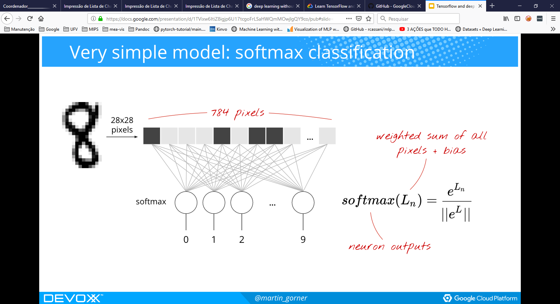
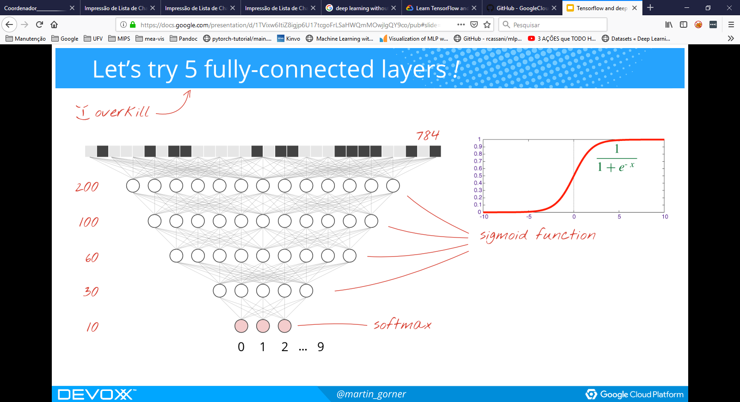
Multilayer perceptron (MLP)
Learn TensorFlow and deep learning, without a Ph.D.

Slide 5
Convolutional neural networks (CNNs)
input layer
convolutional layer
pooling layer
convolutional layer
pooling layer
fully connected layer
softmax layer
p filters
q filters
Class 1
Class 2
Class 3
Class 4
q channels
Class 5
p channels
q channels
p channels
Feature learning
Classification

Slide 6
Convolutional layer

Slide 7
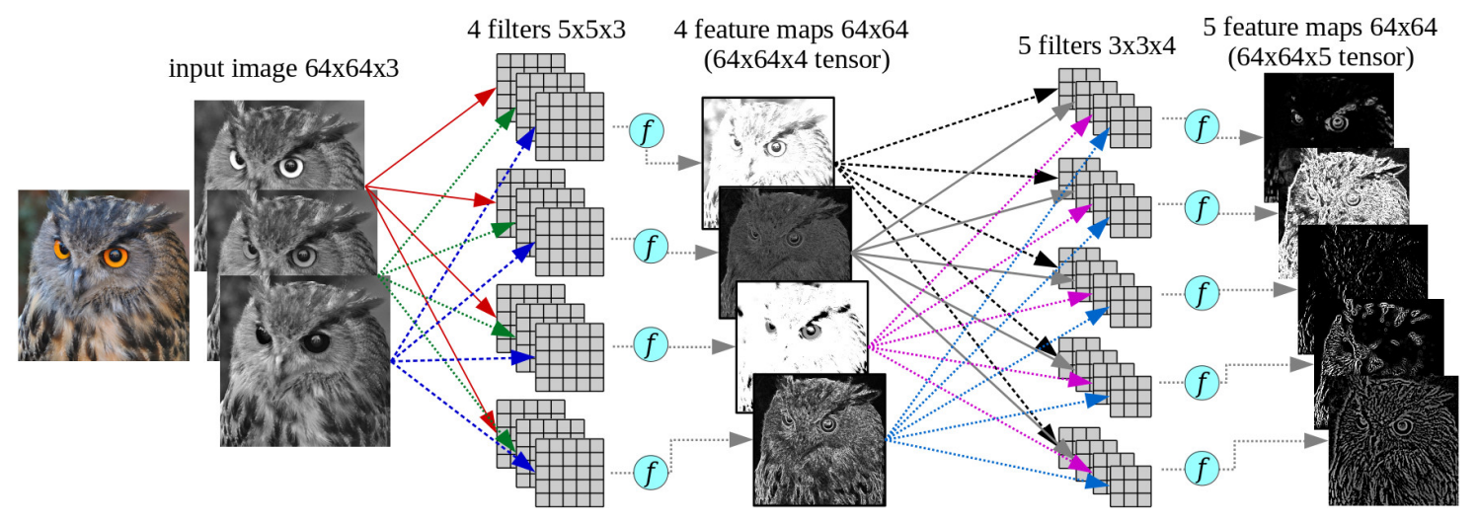
Convolutional layer
Ponti et al. “Everything You Wanted to Know about Deep Learning for Computer Vision but Were Afraid to Ask”. Sibgrapi 2017.

Slide 8
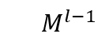
Convolutional layer
$$M_{}^{l−1}$$
...
D channels

Slide 9
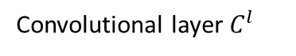
Convolutional layer
Convolutional layer $C_{}^{l}$
$$M_{}^{l−1}$$
k=1
...

Slide 10
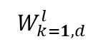
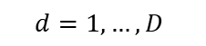
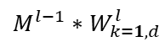
Convolutional layer
Convolutional layer $C_{}^{l}$
$$W_{k=1, d}^{l}$$
$$M_{}^{l−1}$$
k=1
D channels
...
$${M^{l−1}∗W}_{k=1,d}^{l}$$
$$d=1, …,D$$
D channels

Slide 11
Convolutional layer
Convolutional layer $C_{}^{l}$
*
$$W_{k=1, d}^{l}$$
$$M_{}^{l−1}$$
k=1
...
$${M^{l−1}∗W}_{k=1,d}^{l}$$
$$d=1, …,D$$

Slide 12
Convolutional layer
Convolutional layer $C_{}^{l}$
*
*
$$W_{k=1, d}^{l}$$
$$M_{}^{l−1}$$
k=1
...
$${M^{l−1}∗W}_{k=1,d}^{l}$$
$$d=1, …,D$$

Slide 13
Convolutional layer
Convolutional layer $C_{}^{l}$
*
*
...
*
$$W_{k=1, d}^{l}$$
...
$$M_{}^{l−1}$$
k=1
...
$${M^{l−1}∗W}_{k=1,d}^{l}$$
...
$$d=1, …,D$$

Slide 14
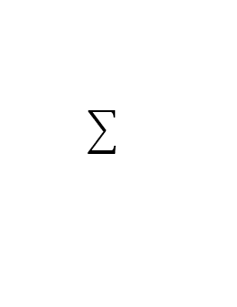
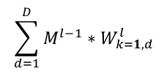
Convolutional layer
Convolutional layer $C_{}^{l}$
*
*
...
*
$$W_{k=1, d}^{l}$$
...
$$\sum_{d=1}^{D}{{M^{l−1}∗W}_{k=1,d}^{l}}$$
$$M_{}^{l−1}$$
k=1
...
$${M^{l−1}∗W}_{k=1,d}^{l}$$
...
$$d=1, …,D$$

Slide 15
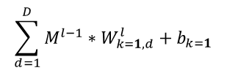
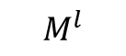
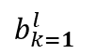
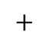
Convolutional layer
Convolutional layer $C_{}^{l}$
*
$$\sum_{d=1}^{D}{{M^{l−1}∗W}_{k=1,d}^{l}}+b_{k=1}$$
*
...
*
$$W_{k=1, d}^{l}$$
...
$$\sum_{d=1}^{D}{{M^{l−1}∗W}_{k=1,d}^{l}}$$
$$M_{}^{l−1}$$
k=1
$b_{k=1}^{l}$
...
$$+$$
$${M^{l−1}∗W}_{k=1,d}^{l}$$
...
$$d=1, …,D$$
$$M_{}^{l}$$
...

Slide 16
Convolutional layer
Convolutional layer $C_{}^{l}$
*
$$\sum_{d=1}^{D}{{M^{l−1}∗W}_{k=1,d}^{l}}+b_{k=1}$$
*
...
*
$$W_{k=1, d}^{l}$$
...
$$\sum_{d=1}^{D}{{M^{l−1}∗W}_{k=1,d}^{l}}$$
$$M_{}^{l−1}$$
k=1
$b_{k=1}^{l}$
...
$$+$$
ReLu
$${M^{l−1}∗W}_{k=1,d}^{l}$$
...
$$d=1, …,D$$
$$M_{}^{l}$$
...

Slide 17
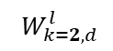
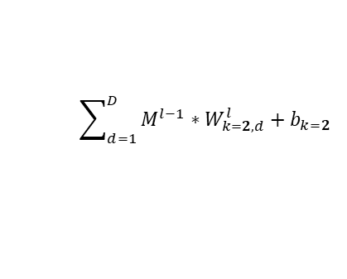
Convolutional layer
Convolutional layer $C_{}^{l}$
*
$$\sum_{d=1}^{D}{{M^{l−1}∗W}_{k=1,d}^{l}}+b_{k=1}$$
*
...
*
$$W_{k=1, d}^{l}$$
...
$$\sum_{d=1}^{D}{{M^{l−1}∗W}_{k=1,d}^{l}}$$
$$M_{}^{l−1}$$
k=1
$b_{k=1}^{l}$
...
$$+$$
ReLu
$${M^{l−1}∗W}_{k=1,d}^{l}$$
...
$$d=1, …,D$$
k=2
$$W_{k=2, d}^{l}$$
$$\sum_{d=1}^{D}{{M^{l−1}∗W}_{k=2,d}^{l}}+b_{k=2}$$
$$M_{}^{l}$$
...
...

Slide 18
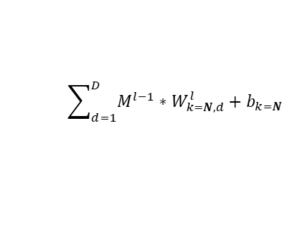
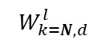
Convolutional layer
Convolutional layer $C_{}^{l}$
*
$$\sum_{d=1}^{D}{{M^{l−1}∗W}_{k=1,d}^{l}}+b_{k=1}$$
*
...
*
$$W_{k=1, d}^{l}$$
...
$$\sum_{d=1}^{D}{{M^{l−1}∗W}_{k=1,d}^{l}}$$
$$M_{}^{l−1}$$
k=1
$b_{k=1}^{l}$
...
$$+$$
ReLu
$${M^{l−1}∗W}_{k=1,d}^{l}$$
...
$$d=1, …,D$$
k=2
$$W_{k=2, d}^{l}$$
$$\sum_{d=1}^{D}{{M^{l−1}∗W}_{k=2,d}^{l}}+b_{k=2}$$
$$M_{}^{l}$$
...
...
...
...
k=N
$$W_{k=N, d}^{l}$$
$$\sum_{d=1}^{D}{{M^{l−1}∗W}_{k=N,d}^{l}}+b_{k=N}$$
...
N channels

Slide 19
Convolutional layer
x[:,:,0] 5×5 + pad 1
w0[:,:,0]
x[:,:,0] * w0[:,:,0]
https://cs231n.github.io/convolutional-networks/
0 | 0 | 0 | 0 | 0 | 0 | 0
0 | 6 | 3 | 4 | 6 | 2 | 0
0 | 7 | 4 | 4 | 6 | 1 | 0
0 | 2 | 6 | 2 | 2 | 7 | 0
0 | 4 | 3 | 7 | 7 | 2 | 0
0 | 5 | 4 | 1 | 7 | 3 | 0
0 | 0 | 0 | 0 | 0 | 0 | 0
-1 | 1 | 1
1 | 1 | 2
0 | -2 | 1
x[:,:,1] * w0[:,:,1]
b0
w0[:,:,1]
1
-1 | 1 | -1
-1 | 1 | 2
-1 | -1 | 1
x[:,:,2] * w0[:,:,2]
x[:,:,1] 5×5 + pad 1
w0[:,:,2]
0 | 0 | 0 | 0 | 0 | 0 | 0
0 | 5 | 5 | 1 | 7 | 3 | 0
0 | 4 | 0 | 3 | 1 | 5 | 0
0 | 4 | 3 | 0 | 0 | 2 | 0
0 | 2 | 6 | 1 | 7 | 3 | 0
0 | 3 | 7 | 6 | 5 | 5 | 0
0 | 0 | 0 | 0 | 0 | 0 | 0
-1 | -1 | 1
1 | -2 | 2
2 | -1 | 2
w1[:,:,0]
x[:,:,0] * w1[:,:,0]
-1 | -2 | 1
1 | 1 | 2
-2 | 2 | 2
x[:,:,1] * w1[:,:,1]
b1
x[:,:,2] 5×5 + pad 1
w1[:,:,1]
0
0 | 0 | 0 | 0 | 0 | 0 | 0
0 | 6 | 5 | 2 | 3 | 6 | 0
0 | 3 | 7 | 0 | 2 | 4 | 0
0 | 2 | 6 | 4 | 0 | 6 | 0
0 | 1 | 3 | 0 | 3 | 5 | 0
0 | 1 | 1 | 0 | 1 | 4 | 0
0 | 0 | 0 | 0 | 0 | 0 | 0
-2 | -2 | -2
-2 | 1 | 0
0 | -2 | 0
x[:,:,2] * w1[:,:,2]
w1[:,:,2]
0 | -2 | 0
2 | -1 | -1
-2 | 1 | -2

Slide 20
Convolutional layer
x[:,:,0] 5×5 + pad 1
w0[:,:,0]
x[:,:,0] * w0[:,:,0]
https://cs231n.github.io/convolutional-networks/
0 | 0 | 0 | 0 | 0 | 0 | 0
0 | 6 | 3 | 4 | 6 | 2 | 0
0 | 7 | 4 | 4 | 6 | 1 | 0
0 | 2 | 6 | 2 | 2 | 7 | 0
0 | 4 | 3 | 7 | 7 | 2 | 0
0 | 5 | 4 | 1 | 7 | 3 | 0
0 | 0 | 0 | 0 | 0 | 0 | 0
-1 | 1 | 1
1 | 1 | 2
0 | -2 | 1
x[:,:,1] * w0[:,:,1]
b0
w0[:,:,1]
1
-1 | 1 | -1
-1 | 1 | 2
-1 | -1 | 1
x[:,:,2] * w0[:,:,2]
x[:,:,1] 5×5 + pad 1
w0[:,:,2]
0 | 0 | 0 | 0 | 0 | 0 | 0
0 | 5 | 5 | 1 | 7 | 3 | 0
0 | 4 | 0 | 3 | 1 | 5 | 0
0 | 4 | 3 | 0 | 0 | 2 | 0
0 | 2 | 6 | 1 | 7 | 3 | 0
0 | 3 | 7 | 6 | 5 | 5 | 0
0 | 0 | 0 | 0 | 0 | 0 | 0
-1 | -1 | 1
1 | -2 | 2
2 | -1 | 2
w1[:,:,0]
x[:,:,0] * w1[:,:,0]
-1 | -2 | 1
1 | 1 | 2
-2 | 2 | 2
x[:,:,1] * w1[:,:,1]
b1
x[:,:,2] 5×5 + pad 1
w1[:,:,1]
0
0 | 0 | 0 | 0 | 0 | 0 | 0
0 | 6 | 5 | 2 | 3 | 6 | 0
0 | 3 | 7 | 0 | 2 | 4 | 0
0 | 2 | 6 | 4 | 0 | 6 | 0
0 | 1 | 3 | 0 | 3 | 5 | 0
0 | 1 | 1 | 0 | 1 | 4 | 0
0 | 0 | 0 | 0 | 0 | 0 | 0
-2 | -2 | -2
-2 | 1 | 0
0 | -2 | 0
x[:,:,2] * w1[:,:,2]
w1[:,:,2]
0 | -2 | 0
2 | -1 | -1
-2 | 1 | -2

Slide 21
Convolutional layer
x[:,:,0] 5×5 + pad 1
w0[:,:,0]
x[:,:,0] * w0[:,:,0]
https://cs231n.github.io/convolutional-networks/
0 | 0 | 0 | 0 | 0 | 0 | 0
0 | 6 | 3 | 4 | 6 | 2 | 0
0 | 7 | 4 | 4 | 6 | 1 | 0
0 | 2 | 6 | 2 | 2 | 7 | 0
0 | 4 | 3 | 7 | 7 | 2 | 0
0 | 5 | 4 | 1 | 7 | 3 | 0
0 | 0 | 0 | 0 | 0 | 0 | 0
-1 | 1 | 1
1 | 1 | 2
0 | -2 | 1
x[:,:,1] * w0[:,:,1]
b0
w0[:,:,1]
1
-1 | 1 | -1
-1 | 1 | 2
-1 | -1 | 1
x[:,:,2] * w0[:,:,2]
x[:,:,1] 5×5 + pad 1
w0[:,:,2]
0 | 0 | 0 | 0 | 0 | 0 | 0
0 | 5 | 5 | 1 | 7 | 3 | 0
0 | 4 | 0 | 3 | 1 | 5 | 0
0 | 4 | 3 | 0 | 0 | 2 | 0
0 | 2 | 6 | 1 | 7 | 3 | 0
0 | 3 | 7 | 6 | 5 | 5 | 0
0 | 0 | 0 | 0 | 0 | 0 | 0
-1 | -1 | 1
1 | -2 | 2
2 | -1 | 2
w1[:,:,0]
x[:,:,0] * w1[:,:,0]
-1 | -2 | 1
1 | 1 | 2
-2 | 2 | 2
x[:,:,1] * w1[:,:,1]
b1
x[:,:,2] 5×5 + pad 1
w1[:,:,1]
0
0 | 0 | 0 | 0 | 0 | 0 | 0
0 | 6 | 5 | 2 | 3 | 6 | 0
0 | 3 | 7 | 0 | 2 | 4 | 0
0 | 2 | 6 | 4 | 0 | 6 | 0
0 | 1 | 3 | 0 | 3 | 5 | 0
0 | 1 | 1 | 0 | 1 | 4 | 0
0 | 0 | 0 | 0 | 0 | 0 | 0
-2 | -2 | -2
-2 | 1 | 0
0 | -2 | 0
x[:,:,2] * w1[:,:,2]
w1[:,:,2]
0 | -2 | 0
2 | -1 | -1
-2 | 1 | -2

Slide 22
Convolutional layer
x[:,:,0] 5×5 + pad 1
w0[:,:,0]
x[:,:,0] * w0[:,:,0]
https://cs231n.github.io/convolutional-networks/
0 | 0 | 0 | 0 | 0 | 0 | 0
0 | 6 | 3 | 4 | 6 | 2 | 0
0 | 7 | 4 | 4 | 6 | 1 | 0
0 | 2 | 6 | 2 | 2 | 7 | 0
0 | 4 | 3 | 7 | 7 | 2 | 0
0 | 5 | 4 | 1 | 7 | 3 | 0
0 | 0 | 0 | 0 | 0 | 0 | 0
-1 | 1 | 1
1 | 1 | 2
0 | -2 | 1
12
x[:,:,1] * w0[:,:,1]
b0
w0[:,:,1]
4
1
-1 | 1 | -1
-1 | 1 | 2
-1 | -1 | 1
x[:,:,2] * w0[:,:,2]
-17
x[:,:,1] 5×5 + pad 1
w0[:,:,2]
0 | 0 | 0 | 0 | 0 | 0 | 0
0 | 5 | 5 | 1 | 7 | 3 | 0
0 | 4 | 0 | 3 | 1 | 5 | 0
0 | 4 | 3 | 0 | 0 | 2 | 0
0 | 2 | 6 | 1 | 7 | 3 | 0
0 | 3 | 7 | 6 | 5 | 5 | 0
0 | 0 | 0 | 0 | 0 | 0 | 0
-1 | -1 | 1
1 | -2 | 2
2 | -1 | 2
w1[:,:,0]
x[:,:,0] * w1[:,:,0]
-1 | -2 | 1
1 | 1 | 2
-2 | 2 | 2
-9
x[:,:,1] * w1[:,:,1]
b1
x[:,:,2] 5×5 + pad 1
w1[:,:,1]
-13
0
0 | 0 | 0 | 0 | 0 | 0 | 0
0 | 6 | 5 | 2 | 3 | 6 | 0
0 | 3 | 7 | 0 | 2 | 4 | 0
0 | 2 | 6 | 4 | 0 | 6 | 0
0 | 1 | 3 | 0 | 3 | 5 | 0
0 | 1 | 1 | 0 | 1 | 4 | 0
0 | 0 | 0 | 0 | 0 | 0 | 0
-2 | -2 | -2
-2 | 1 | 0
0 | -2 | 0
x[:,:,2] * w1[:,:,2]
-2
w1[:,:,2]
0 | -2 | 0
2 | -1 | -1
-2 | 1 | -2

Slide 23
Convolutional layer
x[:,:,0] 5×5 + pad 1
w0[:,:,0]
x[:,:,0] * w0[:,:,0]
https://cs231n.github.io/convolutional-networks/
0 | 0 | 0 | 0 | 0 | 0 | 0
0 | 6 | 3 | 4 | 6 | 2 | 0
0 | 7 | 4 | 4 | 6 | 1 | 0
0 | 2 | 6 | 2 | 2 | 7 | 0
0 | 4 | 3 | 7 | 7 | 2 | 0
0 | 5 | 4 | 1 | 7 | 3 | 0
0 | 0 | 0 | 0 | 0 | 0 | 0
-1 | 1 | 1
1 | 1 | 2
0 | -2 | 1
12 | 26
x[:,:,1] * w0[:,:,1]
b0
w0[:,:,1]
4 | 7
1
-1 | 1 | -1
-1 | 1 | 2
-1 | -1 | 1
x[:,:,2] * w0[:,:,2]
-17 | 0
x[:,:,1] 5×5 + pad 1
w0[:,:,2]
0 | 0 | 0 | 0 | 0 | 0 | 0
0 | 5 | 5 | 1 | 7 | 3 | 0
0 | 4 | 0 | 3 | 1 | 5 | 0
0 | 4 | 3 | 0 | 0 | 2 | 0
0 | 2 | 6 | 1 | 7 | 3 | 0
0 | 3 | 7 | 6 | 5 | 5 | 0
0 | 0 | 0 | 0 | 0 | 0 | 0
-1 | -1 | 1
1 | -2 | 2
2 | -1 | 2
w1[:,:,0]
x[:,:,0] * w1[:,:,0]
-1 | -2 | 1
1 | 1 | 2
-2 | 2 | 2
-9 | 14
x[:,:,1] * w1[:,:,1]
b1
x[:,:,2] 5×5 + pad 1
w1[:,:,1]
-13 | -11
0
0 | 0 | 0 | 0 | 0 | 0 | 0
0 | 6 | 5 | 2 | 3 | 6 | 0
0 | 3 | 7 | 0 | 2 | 4 | 0
0 | 2 | 6 | 4 | 0 | 6 | 0
0 | 1 | 3 | 0 | 3 | 5 | 0
0 | 1 | 1 | 0 | 1 | 4 | 0
0 | 0 | 0 | 0 | 0 | 0 | 0
-2 | -2 | -2
-2 | 1 | 0
0 | -2 | 0
x[:,:,2] * w1[:,:,2]
-2 | -21
w1[:,:,2]
0 | -2 | 0
2 | -1 | -1
-2 | 1 | -2

Slide 24
Convolutional layer
x[:,:,0] 5×5 + pad 1
w0[:,:,0]
x[:,:,0] * w0[:,:,0]
https://cs231n.github.io/convolutional-networks/
0 | 0 | 0 | 0 | 0 | 0 | 0
0 | 6 | 3 | 4 | 6 | 2 | 0
0 | 7 | 4 | 4 | 6 | 1 | 0
0 | 2 | 6 | 2 | 2 | 7 | 0
0 | 4 | 3 | 7 | 7 | 2 | 0
0 | 5 | 4 | 1 | 7 | 3 | 0
0 | 0 | 0 | 0 | 0 | 0 | 0
-1 | 1 | 1
1 | 1 | 2
0 | -2 | 1
12 | 26 | 18
x[:,:,1] * w0[:,:,1]
b0
w0[:,:,1]
4 | 7 | 6
1
-1 | 1 | -1
-1 | 1 | 2
-1 | -1 | 1
x[:,:,2] * w0[:,:,2]
-17 | 0 | 14
x[:,:,1] 5×5 + pad 1
w0[:,:,2]
0 | 0 | 0 | 0 | 0 | 0 | 0
0 | 5 | 5 | 1 | 7 | 3 | 0
0 | 4 | 0 | 3 | 1 | 5 | 0
0 | 4 | 3 | 0 | 0 | 2 | 0
0 | 2 | 6 | 1 | 7 | 3 | 0
0 | 3 | 7 | 6 | 5 | 5 | 0
0 | 0 | 0 | 0 | 0 | 0 | 0
-1 | -1 | 1
1 | -2 | 2
2 | -1 | 2
w1[:,:,0]
x[:,:,0] * w1[:,:,0]
-1 | -2 | 1
1 | 1 | 2
-2 | 2 | 2
-9 | 14 | 6
x[:,:,1] * w1[:,:,1]
b1
x[:,:,2] 5×5 + pad 1
w1[:,:,1]
-13 | -11 | -21
0
0 | 0 | 0 | 0 | 0 | 0 | 0
0 | 6 | 5 | 2 | 3 | 6 | 0
0 | 3 | 7 | 0 | 2 | 4 | 0
0 | 2 | 6 | 4 | 0 | 6 | 0
0 | 1 | 3 | 0 | 3 | 5 | 0
0 | 1 | 1 | 0 | 1 | 4 | 0
0 | 0 | 0 | 0 | 0 | 0 | 0
-2 | -2 | -2
-2 | 1 | 0
0 | -2 | 0
x[:,:,2] * w1[:,:,2]
-2 | -21 | -1
w1[:,:,2]
0 | -2 | 0
2 | -1 | -1
-2 | 1 | -2

Slide 25
Convolutional layer
x[:,:,0] 5×5 + pad 1
w0[:,:,0]
x[:,:,0] * w0[:,:,0]
https://cs231n.github.io/convolutional-networks/
0 | 0 | 0 | 0 | 0 | 0 | 0
0 | 6 | 3 | 4 | 6 | 2 | 0
0 | 7 | 4 | 4 | 6 | 1 | 0
0 | 2 | 6 | 2 | 2 | 7 | 0
0 | 4 | 3 | 7 | 7 | 2 | 0
0 | 5 | 4 | 1 | 7 | 3 | 0
0 | 0 | 0 | 0 | 0 | 0 | 0
-1 | 1 | 1
1 | 1 | 2
0 | -2 | 1
12 | 26 | 18 | 25
x[:,:,1] * w0[:,:,1]
b0
w0[:,:,1]
4 | 7 | 6 | -1
1
-1 | 1 | -1
-1 | 1 | 2
-1 | -1 | 1
x[:,:,2] * w0[:,:,2]
-17 | 0 | 14 | -2
x[:,:,1] 5×5 + pad 1
w0[:,:,2]
0 | 0 | 0 | 0 | 0 | 0 | 0
0 | 5 | 5 | 1 | 7 | 3 | 0
0 | 4 | 0 | 3 | 1 | 5 | 0
0 | 4 | 3 | 0 | 0 | 2 | 0
0 | 2 | 6 | 1 | 7 | 3 | 0
0 | 3 | 7 | 6 | 5 | 5 | 0
0 | 0 | 0 | 0 | 0 | 0 | 0
-1 | -1 | 1
1 | -2 | 2
2 | -1 | 2
w1[:,:,0]
x[:,:,0] * w1[:,:,0]
-1 | -2 | 1
1 | 1 | 2
-2 | 2 | 2
-9 | 14 | 6 | 7
x[:,:,1] * w1[:,:,1]
b1
x[:,:,2] 5×5 + pad 1
w1[:,:,1]
-13 | -11 | -21 | -17
0
0 | 0 | 0 | 0 | 0 | 0 | 0
0 | 6 | 5 | 2 | 3 | 6 | 0
0 | 3 | 7 | 0 | 2 | 4 | 0
0 | 2 | 6 | 4 | 0 | 6 | 0
0 | 1 | 3 | 0 | 3 | 5 | 0
0 | 1 | 1 | 0 | 1 | 4 | 0
0 | 0 | 0 | 0 | 0 | 0 | 0
-2 | -2 | -2
-2 | 1 | 0
0 | -2 | 0
x[:,:,2] * w1[:,:,2]
-2 | -21 | -1 | 3
w1[:,:,2]
0 | -2 | 0
2 | -1 | -1
-2 | 1 | -2

Slide 26
Convolutional layer
x[:,:,0] 5×5 + pad 1
w0[:,:,0]
x[:,:,0] * w0[:,:,0]
https://cs231n.github.io/convolutional-networks/
0 | 0 | 0 | 0 | 0 | 0 | 0
0 | 6 | 3 | 4 | 6 | 2 | 0
0 | 7 | 4 | 4 | 6 | 1 | 0
0 | 2 | 6 | 2 | 2 | 7 | 0
0 | 4 | 3 | 7 | 7 | 2 | 0
0 | 5 | 4 | 1 | 7 | 3 | 0
0 | 0 | 0 | 0 | 0 | 0 | 0
-1 | 1 | 1
1 | 1 | 2
0 | -2 | 1
12 | 26 | 18 | 25 | 21
x[:,:,1] * w0[:,:,1]
b0
w0[:,:,1]
4 | 7 | 6 | -1 | 12
1
-1 | 1 | -1
-1 | 1 | 2
-1 | -1 | 1
x[:,:,2] * w0[:,:,2]
-17 | 0 | 14 | -2 | -8
x[:,:,1] 5×5 + pad 1
w0[:,:,2]
0 | 0 | 0 | 0 | 0 | 0 | 0
0 | 5 | 5 | 1 | 7 | 3 | 0
0 | 4 | 0 | 3 | 1 | 5 | 0
0 | 4 | 3 | 0 | 0 | 2 | 0
0 | 2 | 6 | 1 | 7 | 3 | 0
0 | 3 | 7 | 6 | 5 | 5 | 0
0 | 0 | 0 | 0 | 0 | 0 | 0
-1 | -1 | 1
1 | -2 | 2
2 | -1 | 2
w1[:,:,0]
x[:,:,0] * w1[:,:,0]
-1 | -2 | 1
1 | 1 | 2
-2 | 2 | 2
-9 | 14 | 6 | 7 | 18
x[:,:,1] * w1[:,:,1]
b1
x[:,:,2] 5×5 + pad 1
w1[:,:,1]
-13 | -11 | -21 | -17 | -9
0
0 | 0 | 0 | 0 | 0 | 0 | 0
0 | 6 | 5 | 2 | 3 | 6 | 0
0 | 3 | 7 | 0 | 2 | 4 | 0
0 | 2 | 6 | 4 | 0 | 6 | 0
0 | 1 | 3 | 0 | 3 | 5 | 0
0 | 1 | 1 | 0 | 1 | 4 | 0
0 | 0 | 0 | 0 | 0 | 0 | 0
-2 | -2 | -2
-2 | 1 | 0
0 | -2 | 0
x[:,:,2] * w1[:,:,2]
-2 | -21 | -1 | 3 | -17
w1[:,:,2]
0 | -2 | 0
2 | -1 | -1
-2 | 1 | -2

Slide 27
Convolutional layer
x[:,:,0] 5×5 + pad 1
w0[:,:,0]
x[:,:,0] * w0[:,:,0]
https://cs231n.github.io/convolutional-networks/
0 | 0 | 0 | 0 | 0 | 0 | 0
0 | 6 | 3 | 4 | 6 | 2 | 0
0 | 7 | 4 | 4 | 6 | 1 | 0
0 | 2 | 6 | 2 | 2 | 7 | 0
0 | 4 | 3 | 7 | 7 | 2 | 0
0 | 5 | 4 | 1 | 7 | 3 | 0
0 | 0 | 0 | 0 | 0 | 0 | 0
-1 | 1 | 1
1 | 1 | 2
0 | -2 | 1
12 | 26 | 18 | 25 | 21
-5
x[:,:,1] * w0[:,:,1]
b0
w0[:,:,1]
4 | 7 | 6 | -1 | 12
-5
1
-1 | 1 | -1
-1 | 1 | 2
-1 | -1 | 1
x[:,:,2] * w0[:,:,2]
-17 | 0 | 14 | -2 | -8
-3
x[:,:,1] 5×5 + pad 1
w0[:,:,2]
0 | 0 | 0 | 0 | 0 | 0 | 0
0 | 5 | 5 | 1 | 7 | 3 | 0
0 | 4 | 0 | 3 | 1 | 5 | 0
0 | 4 | 3 | 0 | 0 | 2 | 0
0 | 2 | 6 | 1 | 7 | 3 | 0
0 | 3 | 7 | 6 | 5 | 5 | 0
0 | 0 | 0 | 0 | 0 | 0 | 0
-1 | -1 | 1
1 | -2 | 2
2 | -1 | 2
w1[:,:,0]
x[:,:,0] * w1[:,:,0]
-1 | -2 | 1
1 | 1 | 2
-2 | 2 | 2
-9 | 14 | 6 | 7 | 18
7
x[:,:,1] * w1[:,:,1]
b1
x[:,:,2] 5×5 + pad 1
w1[:,:,1]
-13 | -11 | -21 | -17 | -9
-20
0
0 | 0 | 0 | 0 | 0 | 0 | 0
0 | 6 | 5 | 2 | 3 | 6 | 0
0 | 3 | 7 | 0 | 2 | 4 | 0
0 | 2 | 6 | 4 | 0 | 6 | 0
0 | 1 | 3 | 0 | 3 | 5 | 0
0 | 1 | 1 | 0 | 1 | 4 | 0
0 | 0 | 0 | 0 | 0 | 0 | 0
-2 | -2 | -2
-2 | 1 | 0
0 | -2 | 0
x[:,:,2] * w1[:,:,2]
-2 | -21 | -1 | 3 | -17
3
w1[:,:,2]
0 | -2 | 0
2 | -1 | -1
-2 | 1 | -2

Slide 28
Convolutional layer
x[:,:,0] 5×5 + pad 1
w0[:,:,0]
x[:,:,0] * w0[:,:,0]
https://cs231n.github.io/convolutional-networks/
0 | 0 | 0 | 0 | 0 | 0 | 0
0 | 6 | 3 | 4 | 6 | 2 | 0
0 | 7 | 4 | 4 | 6 | 1 | 0
0 | 2 | 6 | 2 | 2 | 7 | 0
0 | 4 | 3 | 7 | 7 | 2 | 0
0 | 5 | 4 | 1 | 7 | 3 | 0
0 | 0 | 0 | 0 | 0 | 0 | 0
-1 | 1 | 1
1 | 1 | 2
0 | -2 | 1
12 | 26 | 18 | 25 | 21
12
x[:,:,1] * w0[:,:,1]
b0
w0[:,:,1]
4 | 7 | 6 | -1 | 12
4
1
-1 | 1 | -1
-1 | 1 | 2
-1 | -1 | 1
x[:,:,2] * w0[:,:,2]
-17 | 0 | 14 | -2 | -8
-17
x[:,:,1] 5×5 + pad 1
w0[:,:,2]
0 | 0 | 0 | 0 | 0 | 0 | 0
0 | 5 | 5 | 1 | 7 | 3 | 0
0 | 4 | 0 | 3 | 1 | 5 | 0
0 | 4 | 3 | 0 | 0 | 2 | 0
0 | 2 | 6 | 1 | 7 | 3 | 0
0 | 3 | 7 | 6 | 5 | 5 | 0
0 | 0 | 0 | 0 | 0 | 0 | 0
-1 | -1 | 1
1 | -2 | 2
2 | -1 | 2
w1[:,:,0]
x[:,:,0] * w1[:,:,0]
-1 | -2 | 1
1 | 1 | 2
-2 | 2 | 2
-9 | 14 | 6 | 7 | 18
7
x[:,:,1] * w1[:,:,1]
b1
x[:,:,2] 5×5 + pad 1
w1[:,:,1]
-13 | -11 | -21 | -17 | -9
-20
0
0 | 0 | 0 | 0 | 0 | 0 | 0
0 | 6 | 5 | 2 | 3 | 6 | 0
0 | 3 | 7 | 0 | 2 | 4 | 0
0 | 2 | 6 | 4 | 0 | 6 | 0
0 | 1 | 3 | 0 | 3 | 5 | 0
0 | 1 | 1 | 0 | 1 | 4 | 0
0 | 0 | 0 | 0 | 0 | 0 | 0
-2 | -2 | -2
-2 | 1 | 0
0 | -2 | 0
x[:,:,2] * w1[:,:,2]
-2 | -21 | -1 | 3 | -17
3
w1[:,:,2]
0 | -2 | 0
2 | -1 | -1
-2 | 1 | -2

Slide 29
Convolutional layer
x[:,:,0] 5×5 + pad 1
w0[:,:,0]
x[:,:,0] * w0[:,:,0]
https://cs231n.github.io/convolutional-networks/
0 | 0 | 0 | 0 | 0 | 0 | 0
0 | 6 | 3 | 4 | 6 | 2 | 0
0 | 7 | 4 | 4 | 6 | 1 | 0
0 | 2 | 6 | 2 | 2 | 7 | 0
0 | 4 | 3 | 7 | 7 | 2 | 0
0 | 5 | 4 | 1 | 7 | 3 | 0
0 | 0 | 0 | 0 | 0 | 0 | 0
-1 | 1 | 1
1 | 1 | 2
0 | -2 | 1
12 | 26 | 18 | 25 | 21
-5 | 28 | 19 | 4 | 24
-5 | 11 | 15 | 17 | 24
4 | 16 | 20 | 26 | 14
1 | 16 | 5 | 5 | 20
x[:,:,1] * w0[:,:,1]
b0
w0[:,:,1]
4 | 7 | 6 | -1 | 12
-5 | 3 | -4 | -9 | 13
-7 | 15 | -10 | -2 | -6
-15 | 8 | 3 | -2 | 15
-12 | 2 | 13 | 3 | 19
1
-1 | 1 | -1
-1 | 1 | 2
-1 | -1 | 1
x[:,:,2] * w0[:,:,2]
-17 | 0 | 14 | -2 | -8
-3 | -5 | 32 | 11 | -10
9 | -7 | 22 | 12 | -14
9 | 2 | 17 | 14 | -13
4 | -1 | 15 | 9 | -5
x[:,:,1] 5×5 + pad 1
w0[:,:,2]
0 | 0 | 0 | 0 | 0 | 0 | 0
0 | 5 | 5 | 1 | 7 | 3 | 0
0 | 4 | 0 | 3 | 1 | 5 | 0
0 | 4 | 3 | 0 | 0 | 2 | 0
0 | 2 | 6 | 1 | 7 | 3 | 0
0 | 3 | 7 | 6 | 5 | 5 | 0
0 | 0 | 0 | 0 | 0 | 0 | 0
-1 | -1 | 1
1 | -2 | 2
2 | -1 | 2
w1[:,:,0]
x[:,:,0] * w1[:,:,0]
-1 | -2 | 1
1 | 1 | 2
-2 | 2 | 2
-9 | 14 | 6 | 7 | 18
7 | 20 | 20 | 22 | 17
3 | 17 | 2 | 22 | 28
-15 | 26 | 27 | 1 | 35
11 | 15 | 22 | 36 | 35
x[:,:,1] * w1[:,:,1]
b1
x[:,:,2] 5×5 + pad 1
w1[:,:,1]
-13 | -11 | -21 | -17 | -9
-20 | -30 | -7 | -27 | -5
-26 | -15 | -34 | -28 | -28
-38 | -34 | -49 | -31 | -21
-15 | -17 | -6 | -19 | -1
0
0 | 0 | 0 | 0 | 0 | 0 | 0
0 | 6 | 5 | 2 | 3 | 6 | 0
0 | 3 | 7 | 0 | 2 | 4 | 0
0 | 2 | 6 | 4 | 0 | 6 | 0
0 | 1 | 3 | 0 | 3 | 5 | 0
0 | 1 | 1 | 0 | 1 | 4 | 0
0 | 0 | 0 | 0 | 0 | 0 | 0
-2 | -2 | -2
-2 | 1 | 0
0 | -2 | 0
x[:,:,2] * w1[:,:,2]
-2 | -21 | -1 | 3 | -17
3 | -33 | -25 | -7 | -18
-3 | -5 | -28 | -4 | -16
-7 | -12 | -5 | -15 | -10
-4 | -1 | -11 | 0 | -6
w1[:,:,2]
0 | -2 | 0
2 | -1 | -1
-2 | 1 | -2

Slide 30
Convolutional layer
x[:,:,0] 5×5 + pad 1
w0[:,:,0]
x[:,:,0] * w0[:,:,0]
https://cs231n.github.io/convolutional-networks/
0 | 0 | 0 | 0 | 0 | 0 | 0
0 | 6 | 3 | 4 | 6 | 2 | 0
0 | 7 | 4 | 4 | 6 | 1 | 0
0 | 2 | 6 | 2 | 2 | 7 | 0
0 | 4 | 3 | 7 | 7 | 2 | 0
0 | 5 | 4 | 1 | 7 | 3 | 0
0 | 0 | 0 | 0 | 0 | 0 | 0
-1 | 1 | 1
1 | 1 | 2
0 | -2 | 1
12 | 26 | 18 | 25 | 21
-5 | 28 | 19 | 4 | 24
-5 | 11 | 15 | 17 | 24
4 | 16 | 20 | 26 | 14
1 | 16 | 5 | 5 | 20
x[:,:,1] * w0[:,:,1]
b0
w0[:,:,1]
4 | 7 | 6 | -1 | 12
-5 | 3 | -4 | -9 | 13
-7 | 15 | -10 | -2 | -6
-15 | 8 | 3 | -2 | 15
-12 | 2 | 13 | 3 | 19
1
-1 | 1 | -1
-1 | 1 | 2
-1 | -1 | 1
x[:,:,2] * w0[:,:,2]
-17 | 0 | 14 | -2 | -8
-3 | -5 | 32 | 11 | -10
9 | -7 | 22 | 12 | -14
9 | 2 | 17 | 14 | -13
4 | -1 | 15 | 9 | -5
x[:,:,1] 5×5 + pad 1
w0[:,:,2]
0 | 0 | 0 | 0 | 0 | 0 | 0
0 | 5 | 5 | 1 | 7 | 3 | 0
0 | 4 | 0 | 3 | 1 | 5 | 0
0 | 4 | 3 | 0 | 0 | 2 | 0
0 | 2 | 6 | 1 | 7 | 3 | 0
0 | 3 | 7 | 6 | 5 | 5 | 0
0 | 0 | 0 | 0 | 0 | 0 | 0
-1 | -1 | 1
1 | -2 | 2
2 | -1 | 2
w1[:,:,0]
x[:,:,0] * w1[:,:,0]
-1 | -2 | 1
1 | 1 | 2
-2 | 2 | 2
-9 | 14 | 6 | 7 | 18
7 | 20 | 20 | 22 | 17
3 | 17 | 2 | 22 | 28
-15 | 26 | 27 | 1 | 35
11 | 15 | 22 | 36 | 35
x[:,:,1] * w1[:,:,1]
b1
x[:,:,2] 5×5 + pad 1
w1[:,:,1]
-13 | -11 | -21 | -17 | -9
-20 | -30 | -7 | -27 | -5
-26 | -15 | -34 | -28 | -28
-38 | -34 | -49 | -31 | -21
-15 | -17 | -6 | -19 | -1
0
0 | 0 | 0 | 0 | 0 | 0 | 0
0 | 6 | 5 | 2 | 3 | 6 | 0
0 | 3 | 7 | 0 | 2 | 4 | 0
0 | 2 | 6 | 4 | 0 | 6 | 0
0 | 1 | 3 | 0 | 3 | 5 | 0
0 | 1 | 1 | 0 | 1 | 4 | 0
0 | 0 | 0 | 0 | 0 | 0 | 0
-2 | -2 | -2
-2 | 1 | 0
0 | -2 | 0
x[:,:,2] * w1[:,:,2]
-2 | -21 | -1 | 3 | -17
3 | -33 | -25 | -7 | -18
-3 | -5 | -28 | -4 | -16
-7 | -12 | -5 | -15 | -10
-4 | -1 | -11 | 0 | -6
w1[:,:,2]
0 | -2 | 0
2 | -1 | -1
-2 | 1 | -2

Slide 31


Convolutional layer
x[:,:,0] 5×5 + pad 1
w0[:,:,0]
x[:,:,0] * w0[:,:,0]
https://cs231n.github.io/convolutional-networks/
0 | 0 | 0 | 0 | 0 | 0 | 0
0 | 6 | 3 | 4 | 6 | 2 | 0
0 | 7 | 4 | 4 | 6 | 1 | 0
0 | 2 | 6 | 2 | 2 | 7 | 0
0 | 4 | 3 | 7 | 7 | 2 | 0
0 | 5 | 4 | 1 | 7 | 3 | 0
0 | 0 | 0 | 0 | 0 | 0 | 0
-1 | 1 | 1
1 | 1 | 2
0 | -2 | 1
12 | 26 | 18 | 25 | 21
-5 | 28 | 19 | 4 | 24
-5 | 11 | 15 | 17 | 24
4 | 16 | 20 | 26 | 14
1 | 16 | 5 | 5 | 20
x[:,:,1] * w0[:,:,1]
b0
v[:,:,0]
w0[:,:,1]
4 | 7 | 6 | -1 | 12
-5 | 3 | -4 | -9 | 13
-7 | 15 | -10 | -2 | -6
-15 | 8 | 3 | -2 | 15
-12 | 2 | 13 | 3 | 19
1
-1 | 1 | -1
-1 | 1 | 2
-1 | -1 | 1
$$∑$$
x[:,:,2] * w0[:,:,2]
-17 | 0 | 14 | -2 | -8
-3 | -5 | 32 | 11 | -10
9 | -7 | 22 | 12 | -14
9 | 2 | 17 | 14 | -13
4 | -1 | 15 | 9 | -5
x[:,:,1] 5×5 + pad 1
w0[:,:,2]
0 | 0 | 0 | 0 | 0 | 0 | 0
0 | 5 | 5 | 1 | 7 | 3 | 0
0 | 4 | 0 | 3 | 1 | 5 | 0
0 | 4 | 3 | 0 | 0 | 2 | 0
0 | 2 | 6 | 1 | 7 | 3 | 0
0 | 3 | 7 | 6 | 5 | 5 | 0
0 | 0 | 0 | 0 | 0 | 0 | 0
-1 | -1 | 1
1 | -2 | 2
2 | -1 | 2
w1[:,:,0]
x[:,:,0] * w1[:,:,0]
-1 | -2 | 1
1 | 1 | 2
-2 | 2 | 2
-9 | 14 | 6 | 7 | 18
7 | 20 | 20 | 22 | 17
3 | 17 | 2 | 22 | 28
-15 | 26 | 27 | 1 | 35
11 | 15 | 22 | 36 | 35
x[:,:,1] * w1[:,:,1]
b1
v[:,:,1]
x[:,:,2] 5×5 + pad 1
w1[:,:,1]
-13 | -11 | -21 | -17 | -9
-20 | -30 | -7 | -27 | -5
-26 | -15 | -34 | -28 | -28
-38 | -34 | -49 | -31 | -21
-15 | -17 | -6 | -19 | -1
0
0 | 0 | 0 | 0 | 0 | 0 | 0
0 | 6 | 5 | 2 | 3 | 6 | 0
0 | 3 | 7 | 0 | 2 | 4 | 0
0 | 2 | 6 | 4 | 0 | 6 | 0
0 | 1 | 3 | 0 | 3 | 5 | 0
0 | 1 | 1 | 0 | 1 | 4 | 0
0 | 0 | 0 | 0 | 0 | 0 | 0
-2 | -2 | -2
-2 | 1 | 0
0 | -2 | 0
$$∑$$
x[:,:,2] * w1[:,:,2]
-2 | -21 | -1 | 3 | -17
3 | -33 | -25 | -7 | -18
-3 | -5 | -28 | -4 | -16
-7 | -12 | -5 | -15 | -10
-4 | -1 | -11 | 0 | -6
w1[:,:,2]
0 | -2 | 0
2 | -1 | -1
-2 | 1 | -2

Slide 32
Convolutional layer
x[:,:,0] 5×5 + pad 1
w0[:,:,0]
x[:,:,0] * w0[:,:,0]
https://cs231n.github.io/convolutional-networks/
0 | 0 | 0 | 0 | 0 | 0 | 0
0 | 6 | 3 | 4 | 6 | 2 | 0
0 | 7 | 4 | 4 | 6 | 1 | 0
0 | 2 | 6 | 2 | 2 | 7 | 0
0 | 4 | 3 | 7 | 7 | 2 | 0
0 | 5 | 4 | 1 | 7 | 3 | 0
0 | 0 | 0 | 0 | 0 | 0 | 0
-1 | 1 | 1
1 | 1 | 2
0 | -2 | 1
12 | 26 | 18 | 25 | 21
-5 | 28 | 19 | 4 | 24
-5 | 11 | 15 | 17 | 24
4 | 16 | 20 | 26 | 14
1 | 16 | 5 | 5 | 20
x[:,:,1] * w0[:,:,1]
b0
v[:,:,0]
w0[:,:,1]
4 | 7 | 6 | -1 | 12
-5 | 3 | -4 | -9 | 13
-7 | 15 | -10 | -2 | -6
-15 | 8 | 3 | -2 | 15
-12 | 2 | 13 | 3 | 19
1
0 | 34 | 39 | 23 | 35
-12 | 27 | 48 | 7 | 28
-2 | 20 | 28 | 48 | 5
-1 | 27 | 41 | 39 | 17
-6 | 15 | 34 | 18 | 35
-1 | 1 | -1
-1 | 1 | 2
-1 | -1 | 1
$$∑$$
x[:,:,2] * w0[:,:,2]
-17 | 0 | 14 | -2 | -8
-3 | -5 | 32 | 11 | -10
9 | -7 | 22 | 12 | -14
9 | 2 | 17 | 14 | -13
4 | -1 | 15 | 9 | -5
x[:,:,1] 5×5 + pad 1
w0[:,:,2]
0 | 0 | 0 | 0 | 0 | 0 | 0
0 | 5 | 5 | 1 | 7 | 3 | 0
0 | 4 | 0 | 3 | 1 | 5 | 0
0 | 4 | 3 | 0 | 0 | 2 | 0
0 | 2 | 6 | 1 | 7 | 3 | 0
0 | 3 | 7 | 6 | 5 | 5 | 0
0 | 0 | 0 | 0 | 0 | 0 | 0
-1 | -1 | 1
1 | -2 | 2
2 | -1 | 2
w1[:,:,0]
x[:,:,0] * w1[:,:,0]
-1 | -2 | 1
1 | 1 | 2
-2 | 2 | 2
-9 | 14 | 6 | 7 | 18
7 | 20 | 20 | 22 | 17
3 | 17 | 2 | 22 | 28
-15 | 26 | 27 | 1 | 35
11 | 15 | 22 | 36 | 35
x[:,:,1] * w1[:,:,1]
b1
v[:,:,1]
x[:,:,2] 5×5 + pad 1
w1[:,:,1]
-13 | -11 | -21 | -17 | -9
-20 | -30 | -7 | -27 | -5
-26 | -15 | -34 | -28 | -28
-38 | -34 | -49 | -31 | -21
-15 | -17 | -6 | -19 | -1
0
-24 | -18 | -16 | -7 | -8
-10 | -43 | -12 | -12 | -6
-26 | -3 | -60 | -10 | -16
-60 | -20 | -27 | -45 | 4
-8 | -3 | 5 | 17 | 28
0 | 0 | 0 | 0 | 0 | 0 | 0
0 | 6 | 5 | 2 | 3 | 6 | 0
0 | 3 | 7 | 0 | 2 | 4 | 0
0 | 2 | 6 | 4 | 0 | 6 | 0
0 | 1 | 3 | 0 | 3 | 5 | 0
0 | 1 | 1 | 0 | 1 | 4 | 0
0 | 0 | 0 | 0 | 0 | 0 | 0
-2 | -2 | -2
-2 | 1 | 0
0 | -2 | 0
$$∑$$
x[:,:,2] * w1[:,:,2]
-2 | -21 | -1 | 3 | -17
3 | -33 | -25 | -7 | -18
-3 | -5 | -28 | -4 | -16
-7 | -12 | -5 | -15 | -10
-4 | -1 | -11 | 0 | -6
w1[:,:,2]
0 | -2 | 0
2 | -1 | -1
-2 | 1 | -2

Slide 33

Convolutional layer
x[:,:,0] 5×5 + pad 1
w0[:,:,0]
x[:,:,0] * w0[:,:,0]
https://cs231n.github.io/convolutional-networks/
0 | 0 | 0 | 0 | 0 | 0 | 0
0 | 6 | 3 | 4 | 6 | 2 | 0
0 | 7 | 4 | 4 | 6 | 1 | 0
0 | 2 | 6 | 2 | 2 | 7 | 0
0 | 4 | 3 | 7 | 7 | 2 | 0
0 | 5 | 4 | 1 | 7 | 3 | 0
0 | 0 | 0 | 0 | 0 | 0 | 0
-1 | 1 | 1
1 | 1 | 2
0 | -2 | 1
12 | 26 | 18 | 25 | 21
-5 | 28 | 19 | 4 | 24
-5 | 11 | 15 | 17 | 24
4 | 16 | 20 | 26 | 14
1 | 16 | 5 | 5 | 20
x[:,:,1] * w0[:,:,1]
b0
v[:,:,0]
y[:,:,0]
w0[:,:,1]
4 | 7 | 6 | -1 | 12
-5 | 3 | -4 | -9 | 13
-7 | 15 | -10 | -2 | -6
-15 | 8 | 3 | -2 | 15
-12 | 2 | 13 | 3 | 19
1
0 | 34 | 39 | 23 | 35
-12 | 27 | 48 | 7 | 28
-2 | 20 | 28 | 48 | 5
-1 | 27 | 41 | 39 | 17
-6 | 15 | 34 | 18 | 35
-1 | 1 | -1
-1 | 1 | 2
-1 | -1 | 1
$$∑$$
x[:,:,2] * w0[:,:,2]
$$f$$
-17 | 0 | 14 | -2 | -8
-3 | -5 | 32 | 11 | -10
9 | -7 | 22 | 12 | -14
9 | 2 | 17 | 14 | -13
4 | -1 | 15 | 9 | -5
x[:,:,1] 5×5 + pad 1
w0[:,:,2]
ReLu
0 | 0 | 0 | 0 | 0 | 0 | 0
0 | 5 | 5 | 1 | 7 | 3 | 0
0 | 4 | 0 | 3 | 1 | 5 | 0
0 | 4 | 3 | 0 | 0 | 2 | 0
0 | 2 | 6 | 1 | 7 | 3 | 0
0 | 3 | 7 | 6 | 5 | 5 | 0
0 | 0 | 0 | 0 | 0 | 0 | 0
-1 | -1 | 1
1 | -2 | 2
2 | -1 | 2
w1[:,:,0]
x[:,:,0] * w1[:,:,0]
-1 | -2 | 1
1 | 1 | 2
-2 | 2 | 2
-9 | 14 | 6 | 7 | 18
7 | 20 | 20 | 22 | 17
3 | 17 | 2 | 22 | 28
-15 | 26 | 27 | 1 | 35
11 | 15 | 22 | 36 | 35
x[:,:,1] * w1[:,:,1]
b1
v[:,:,1]
y[:,:,1]
x[:,:,2] 5×5 + pad 1
w1[:,:,1]
-13 | -11 | -21 | -17 | -9
-20 | -30 | -7 | -27 | -5
-26 | -15 | -34 | -28 | -28
-38 | -34 | -49 | -31 | -21
-15 | -17 | -6 | -19 | -1
0
-24 | -18 | -16 | -7 | -8
-10 | -43 | -12 | -12 | -6
-26 | -3 | -60 | -10 | -16
-60 | -20 | -27 | -45 | 4
-8 | -3 | 5 | 17 | 28
0 | 0 | 0 | 0 | 0 | 0 | 0
0 | 6 | 5 | 2 | 3 | 6 | 0
0 | 3 | 7 | 0 | 2 | 4 | 0
0 | 2 | 6 | 4 | 0 | 6 | 0
0 | 1 | 3 | 0 | 3 | 5 | 0
0 | 1 | 1 | 0 | 1 | 4 | 0
0 | 0 | 0 | 0 | 0 | 0 | 0
-2 | -2 | -2
-2 | 1 | 0
0 | -2 | 0
$$∑$$
x[:,:,2] * w1[:,:,2]
$$f$$
-2 | -21 | -1 | 3 | -17
3 | -33 | -25 | -7 | -18
-3 | -5 | -28 | -4 | -16
-7 | -12 | -5 | -15 | -10
-4 | -1 | -11 | 0 | -6
w1[:,:,2]
ReLu
0 | -2 | 0
2 | -1 | -1
-2 | 1 | -2

Slide 34
Convolutional layer
x[:,:,0] 5×5 + pad 1
w0[:,:,0]
x[:,:,0] * w0[:,:,0]
https://cs231n.github.io/convolutional-networks/
0 | 0 | 0 | 0 | 0 | 0 | 0
0 | 6 | 3 | 4 | 6 | 2 | 0
0 | 7 | 4 | 4 | 6 | 1 | 0
0 | 2 | 6 | 2 | 2 | 7 | 0
0 | 4 | 3 | 7 | 7 | 2 | 0
0 | 5 | 4 | 1 | 7 | 3 | 0
0 | 0 | 0 | 0 | 0 | 0 | 0
-1 | 1 | 1
1 | 1 | 2
0 | -2 | 1
12 | 26 | 18 | 25 | 21
-5 | 28 | 19 | 4 | 24
-5 | 11 | 15 | 17 | 24
4 | 16 | 20 | 26 | 14
1 | 16 | 5 | 5 | 20
x[:,:,1] * w0[:,:,1]
b0
v[:,:,0]
y[:,:,0]
w0[:,:,1]
4 | 7 | 6 | -1 | 12
-5 | 3 | -4 | -9 | 13
-7 | 15 | -10 | -2 | -6
-15 | 8 | 3 | -2 | 15
-12 | 2 | 13 | 3 | 19
1
0 | 34 | 39 | 23 | 35
-12 | 27 | 48 | 7 | 28
-2 | 20 | 28 | 48 | 5
-1 | 27 | 41 | 39 | 17
-6 | 15 | 34 | 18 | 35
0 | 34 | 39 | 23 | 35
0 | 27 | 48 | 7 | 28
0 | 20 | 28 | 48 | 5
0 | 27 | 41 | 39 | 17
0 | 15 | 34 | 18 | 35
-1 | 1 | -1
-1 | 1 | 2
-1 | -1 | 1
$$∑$$
x[:,:,2] * w0[:,:,2]
$$f$$
-17 | 0 | 14 | -2 | -8
-3 | -5 | 32 | 11 | -10
9 | -7 | 22 | 12 | -14
9 | 2 | 17 | 14 | -13
4 | -1 | 15 | 9 | -5
x[:,:,1] 5×5 + pad 1
w0[:,:,2]
ReLu
0 | 0 | 0 | 0 | 0 | 0 | 0
0 | 5 | 5 | 1 | 7 | 3 | 0
0 | 4 | 0 | 3 | 1 | 5 | 0
0 | 4 | 3 | 0 | 0 | 2 | 0
0 | 2 | 6 | 1 | 7 | 3 | 0
0 | 3 | 7 | 6 | 5 | 5 | 0
0 | 0 | 0 | 0 | 0 | 0 | 0
-1 | -1 | 1
1 | -2 | 2
2 | -1 | 2
w1[:,:,0]
x[:,:,0] * w1[:,:,0]
-1 | -2 | 1
1 | 1 | 2
-2 | 2 | 2
-9 | 14 | 6 | 7 | 18
7 | 20 | 20 | 22 | 17
3 | 17 | 2 | 22 | 28
-15 | 26 | 27 | 1 | 35
11 | 15 | 22 | 36 | 35
x[:,:,1] * w1[:,:,1]
b1
v[:,:,1]
y[:,:,1]
x[:,:,2] 5×5 + pad 1
w1[:,:,1]
-13 | -11 | -21 | -17 | -9
-20 | -30 | -7 | -27 | -5
-26 | -15 | -34 | -28 | -28
-38 | -34 | -49 | -31 | -21
-15 | -17 | -6 | -19 | -1
0
-24 | -18 | -16 | -7 | -8
-10 | -43 | -12 | -12 | -6
-26 | -3 | -60 | -10 | -16
-60 | -20 | -27 | -45 | 4
-8 | -3 | 5 | 17 | 28
0 | 0 | 0 | 0 | 0
0 | 0 | 0 | 0 | 0
0 | 0 | 0 | 0 | 0
0 | 0 | 0 | 0 | 4
0 | 0 | 5 | 17 | 28
0 | 0 | 0 | 0 | 0 | 0 | 0
0 | 6 | 5 | 2 | 3 | 6 | 0
0 | 3 | 7 | 0 | 2 | 4 | 0
0 | 2 | 6 | 4 | 0 | 6 | 0
0 | 1 | 3 | 0 | 3 | 5 | 0
0 | 1 | 1 | 0 | 1 | 4 | 0
0 | 0 | 0 | 0 | 0 | 0 | 0
-2 | -2 | -2
-2 | 1 | 0
0 | -2 | 0
$$∑$$
x[:,:,2] * w1[:,:,2]
$$f$$
-2 | -21 | -1 | 3 | -17
3 | -33 | -25 | -7 | -18
-3 | -5 | -28 | -4 | -16
-7 | -12 | -5 | -15 | -10
-4 | -1 | -11 | 0 | -6
w1[:,:,2]
ReLu
0 | -2 | 0
2 | -1 | -1
-2 | 1 | -2

Slide 35
Pooling layer

Slide 36
Pooling layer
0.2 | 0.5 | 0.7 | 0.4
0.4 | 0.1 | 0.3 | 0.6
0.4 | 0.1 | 0.7 | 0.5
0.3 | 0.2 | 0.5 | 0.9
H
D
W

Slide 37
Pooling layer
0.2 | 0.5 | 0.7 | 0.4
0.4 | 0.1 | 0.3 | 0.6
0.4 | 0.1 | 0.7 | 0.5
0.3 | 0.2 | 0.5 | 0.9
H
Max-pooling
(2 x 2)
0.5 | 0.7
0.4 | 0.9
H/2
D
W/2
D
W

Slide 38
Pooling layer
0.2 | 0.5 | 0.7 | 0.4
0.4 | 0.1 | 0.3 | 0.6
0.4 | 0.1 | 0.7 | 0.5
0.3 | 0.2 | 0.5 | 0.9
H
Max-pooling
(2 x 2)
0.5 | 0.7
0.4 | 0.9
H/2
D
W/2
D
W
0.2 | 0.5 | 0.7 | 0.4
0.4 | 0.1 | 0.3 | 0.6
0.4 | 0.1 | 0.7 | 0.5
0.3 | 0.2 | 0.5 | 0.9
H
D
W

Slide 39
Pooling layer
0.2 | 0.5 | 0.7 | 0.4
0.4 | 0.1 | 0.3 | 0.6
0.4 | 0.1 | 0.7 | 0.5
0.3 | 0.2 | 0.5 | 0.9
H
Max-pooling
(2 x 2)
0.5 | 0.7
0.4 | 0.9
H/2
D
W/2
D
W
0.2 | 0.5 | 0.7 | 0.4
0.4 | 0.1 | 0.3 | 0.6
0.4 | 0.1 | 0.7 | 0.5
0.3 | 0.2 | 0.5 | 0.9
H
Average-pooling
(2 x 2)
0.2 | 0.5
0.4 | 0.1
H/2
D
W/2
D
W

Slide 40
Activation function

Slide 41
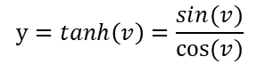



Activation function
Logistic
Hyperbolic tangent
ReLu
PReLu
1
1
1
1
0.5
0.5
0.5
0.5
0
0
0
0
-0.5
-0.5
-0.5
-0.5
-1
-1
-1
-1
$$y=\frac{1}{1+e^{−v}}$$
$$y=tanh\left(v\right)=\frac{sin(v)}{cos⁡(v)}$$
$$y=max⁡(0,v)$$
$$y=max⁡(av,v)$$
If a=0.01 → Leak ReLu

Slide 42
Fully connected layer

Slide 43
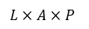

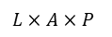
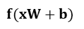


Fully connected layer
$$x$$
$$W$$
$$f(xW+b)$$
...
$$…$$
$$L×A×P$$
$$L×A×P$$

Slide 44
Output layer - softmax

Slide 45
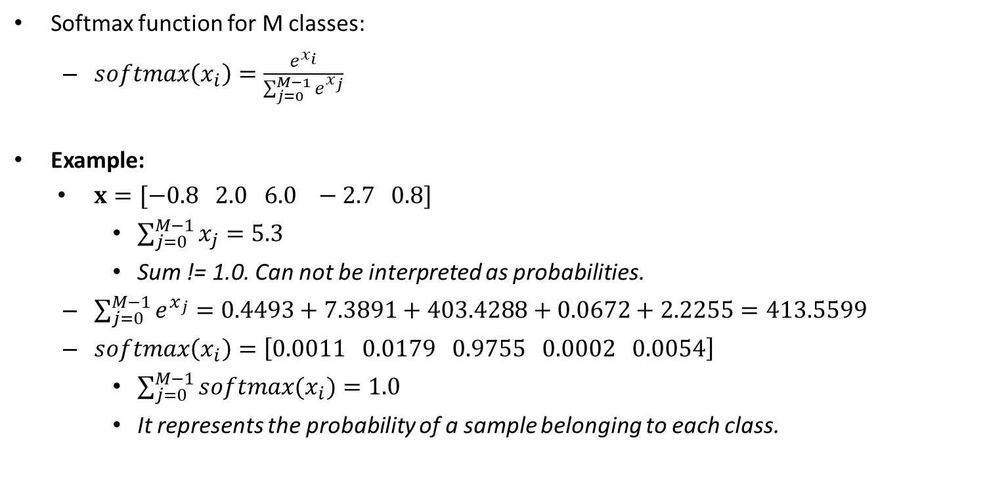
Output layer - softmax
Softmax function for M classes:
$softmax\left(x_{i}\right)=\frac{e^{x_{i}}}{\sum_{j=0}^{M−1}{e^{x_{j}}}}$
Example:
$x=[−0.8 2.0 6.0 −2.7 0.8]$
$\sum_{j=0}^{M−1}{x_{j}}=5.3$
Sum != 1.0. Can not be interpreted as probabilities.
$\sum_{j=0}^{M−1}{e^{x_{j}}}=0.4493+7.3891+403.4288+0.0672+2.2255=413.5599$
$softmax\left(x_{i}\right)=\left[0.0011 0.0179 0.9755 0.0002 0.0054\right]$
$\sum_{j=0}^{M−1}{softmax(x_{i})}=1.0$
It represents the probability of a sample belonging to each class.

Slide 46
Loss function

Slide 47
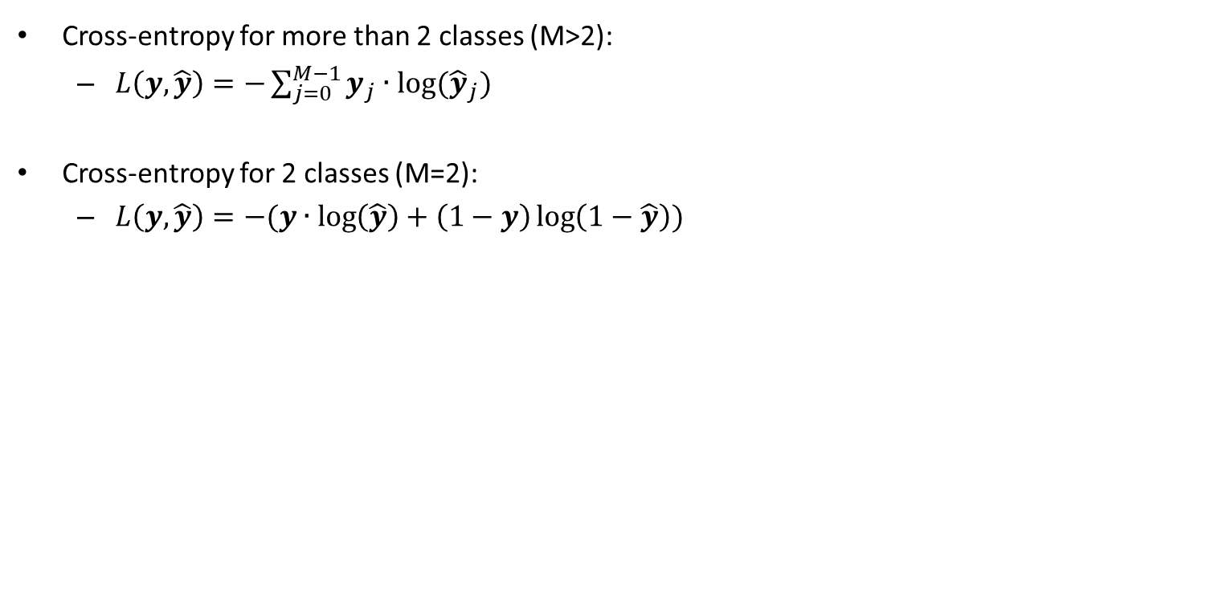
Loss function
Cross-entropy for more than 2 classes (M>2):
$L\left(y, \hat{y}\right)=−\sum_{j=0}^{M−1}{y_{j}∙log⁡({\hat{y}}_{j})}$
Cross-entropy for 2 classes (M=2):
$L\left(y, \hat{y}\right)=−(y∙\log\left(\hat{y}\right)+\left(1−y\right)\log\left(1−\hat{y}\right))$

Slide 48
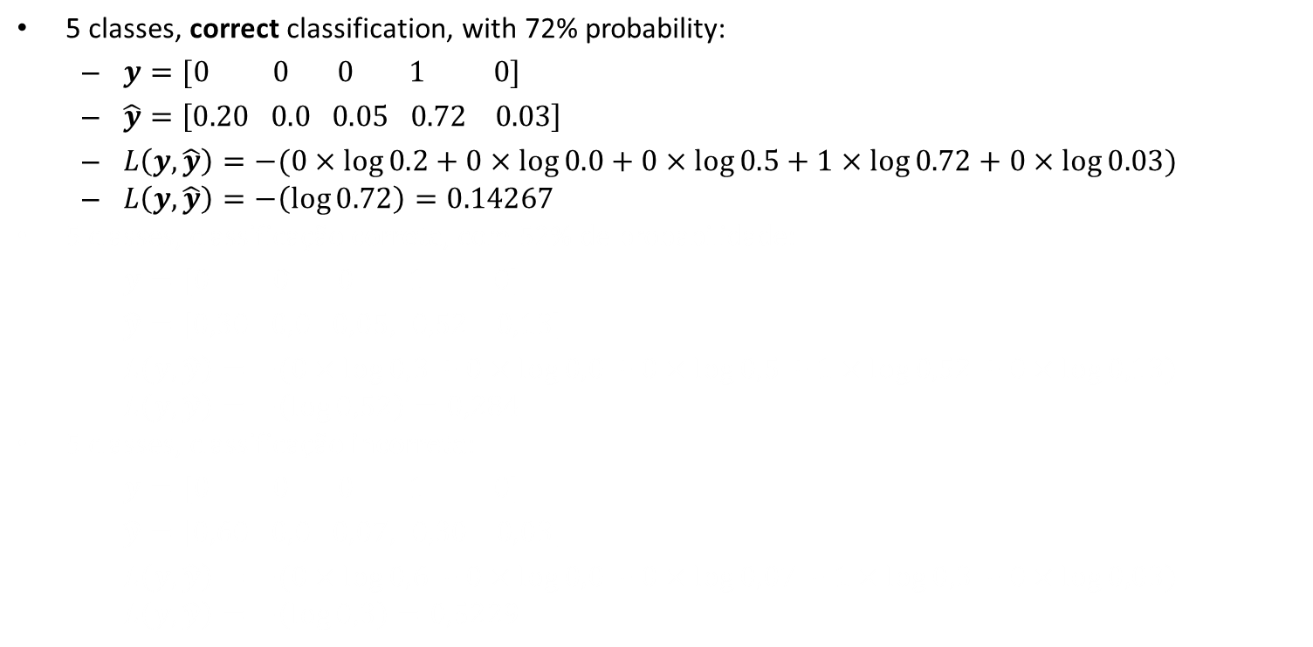
Cross-entropy for M>2
5 classes, correct classification, with 72% probability:
$y=[0 0 0 1 0]$
$\hat{y}=\left[0.20 0.0 0.05 0.72 0.03\right]$
$L\left(y, \hat{y}\right)=−(0×\log{0.2}+0×\log{0.0}+0×\log{0.5}+1×\log{0.72}+0×\log{0.03})$
$L\left(y, \hat{y}\right)=−\left(\log{0.72}\right)=0.14267$
5 classes, classificação correta, com 52% de probabilidade:
$y=[0 0 0 1 0]$
$\hat{y}=\left[0,30 0,0 0,05, 0,52 0,13\right]$
$L\left(y, \hat{y}\right)=−(0×\log{0,3}+0×\log{0,0}+0×\log{0,5}+1×\log{0,52}+0×\log{0,13})$
$L\left(y, \hat{y}\right)=−\left(\log{0,52}\right)=0,284$
5 classes, classificação incorreta:
$y=[0 0 0 1 0]$
$\hat{y}=\left[0,60 0,0 0,07, 0,30 0,03\right]$
$L\left(y, \hat{y}\right)=−(0×\log{0,6}+0×\log{0,0}+0×\log{0,07}+1×\log{0,3}+0×\log{0,03})$
$L\left(y, \hat{y}\right)=−\left(\log{0,3}\right)=0,5229$

Slide 49
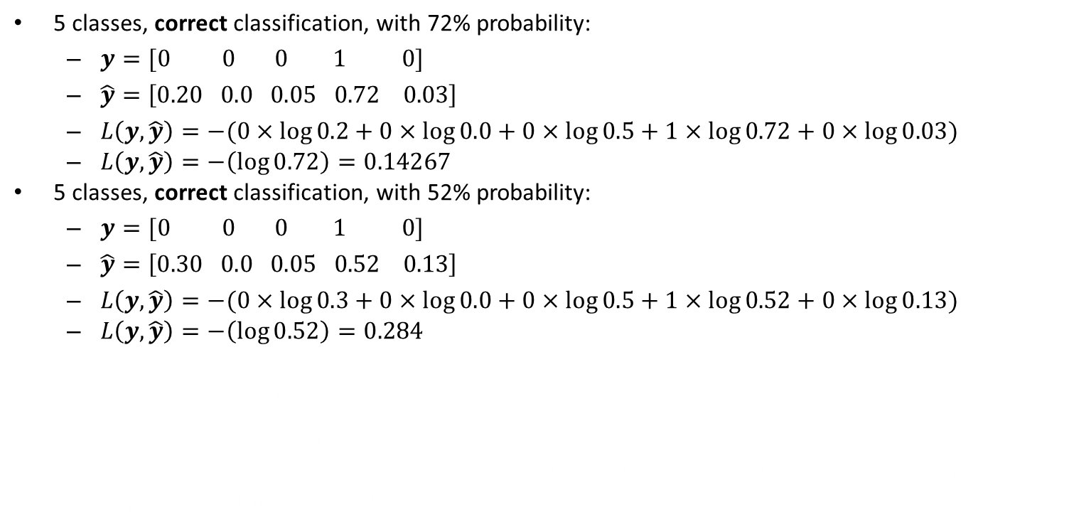
Cross-entropy for M>2
5 classes, correct classification, with 72% probability:
$y=[0 0 0 1 0]$
$\hat{y}=\left[0.20 0.0 0.05 0.72 0.03\right]$
$L\left(y, \hat{y}\right)=−(0×\log{0.2}+0×\log{0.0}+0×\log{0.5}+1×\log{0.72}+0×\log{0.03})$
$L\left(y, \hat{y}\right)=−\left(\log{0.72}\right)=0.14267$
5 classes, correct classification, with 52% probability:
$y=[0 0 0 1 0]$
$\hat{y}=\left[0.30 0.0 0.05 0.52 0.13\right]$
$L\left(y, \hat{y}\right)=−(0×\log{0.3}+0×\log{0.0}+0×\log{0.5}+1×\log{0.52}+0×\log{0.13})$
$L\left(y, \hat{y}\right)=−\left(\log{0.52}\right)=0.284$
5 classes, classificação incorreta:
$y=[0 0 0 1 0]$
$\hat{y}=\left[0,60 0,0 0,07, 0,30 0,03\right]$
$L\left(y, \hat{y}\right)=−(0×\log{0,6}+0×\log{0,0}+0×\log{0,07}+1×\log{0,3}+0×\log{0,03})$
$L\left(y, \hat{y}\right)=−\left(\log{0,3}\right)=0,5229$

Slide 50
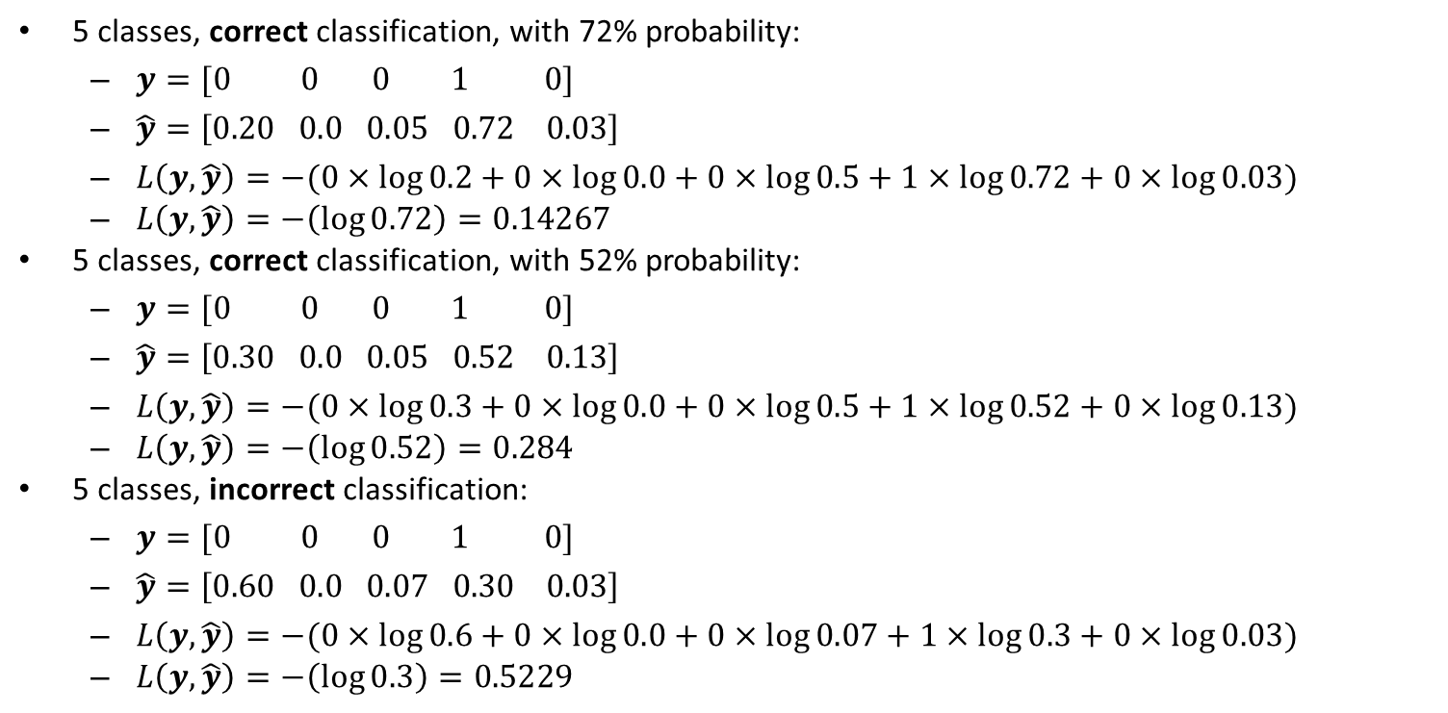
Cross-entropy for M>2
5 classes, correct classification, with 72% probability:
$y=[0 0 0 1 0]$
$\hat{y}=\left[0.20 0.0 0.05 0.72 0.03\right]$
$L\left(y, \hat{y}\right)=−(0×\log{0.2}+0×\log{0.0}+0×\log{0.5}+1×\log{0.72}+0×\log{0.03})$
$L\left(y, \hat{y}\right)=−\left(\log{0.72}\right)=0.14267$
5 classes, correct classification, with 52% probability:
$y=[0 0 0 1 0]$
$\hat{y}=\left[0.30 0.0 0.05 0.52 0.13\right]$
$L\left(y, \hat{y}\right)=−(0×\log{0.3}+0×\log{0.0}+0×\log{0.5}+1×\log{0.52}+0×\log{0.13})$
$L\left(y, \hat{y}\right)=−\left(\log{0.52}\right)=0.284$
5 classes, incorrect classification:
$y=[0 0 0 1 0]$
$\hat{y}=\left[0.60 0.0 0.07 0.30 0.03\right]$
$L\left(y, \hat{y}\right)=−(0×\log{0.6}+0×\log{0.0}+0×\log{0.07}+1×\log{0.3}+0×\log{0.03})$
$L\left(y, \hat{y}\right)=−\left(\log{0.3}\right)=0.5229$

Slide 51

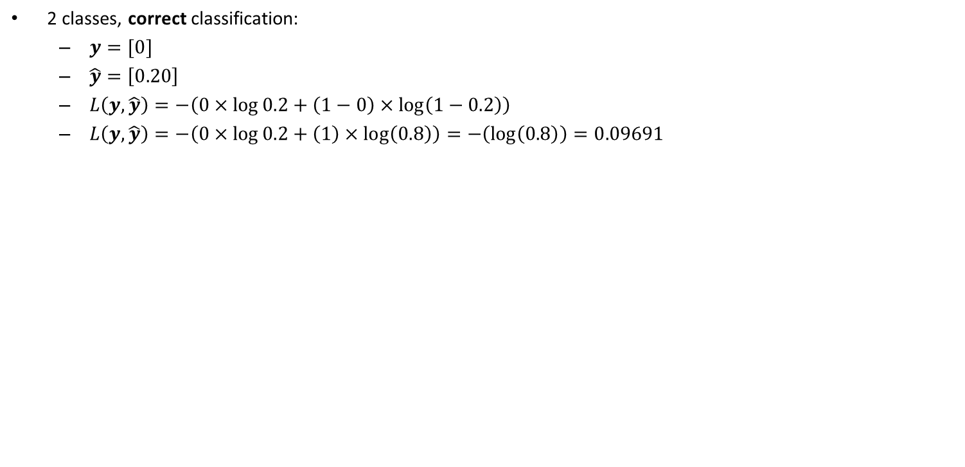
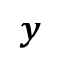
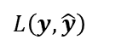
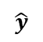
Cross-entropy for M=2
2 classes, correct classification:
$y=[0]$
$\hat{y}=\left[0.20\right]$
$L\left(y, \hat{y}\right)=−\left(0×\log{0.2}+\left(1−0\right)×\log\left(1−0.2\right)\right)$
$L\left(y, \hat{y}\right)=−\left(0×\log{0.2}+\left(1\right)×\log\left(0.8\right)\right)=−\left(\log\left(0.8\right)\right)=0.09691$
2 classes, classificação correta:
$y=[1]$
$\hat{y}=\left[0,92\right]$
$L\left(y, \hat{y}\right)=−\left(1×\log{0,92}+\left(1−1\right)×\log\left(1−0,92\right)\right)$
$L\left(y, \hat{y}\right)=−\left(1×\log{0,92}+\left(0\right)×\log\left(0,08\right)\right)=−\left(\log\left(0,92\right)\right)=0,03621$
2 classes, classificação incorreta:
$y=[0]$
$\hat{y}=\left[0,65\right]$
$L\left(y, \hat{y}\right)=−\left(0×\log{0,65}+\left(1−0\right)×\log\left(1−0,65\right)\right)$
$L\left(y, \hat{y}\right)=−\left(0×\log{0,65}+\left(1\right)×\log\left(0,35\right)\right)=−\left(\log\left(0,35\right)\right)=0,45593$
1.0
1.0
θ = 0.5
θ = 0.0
–1.0
–1.0
Logistic
Hyperbolic tangent
$$\hat{y}$$
$$L$$
$$L\left(y, \hat{y}\right)$$
...
$$y$$

Slide 52
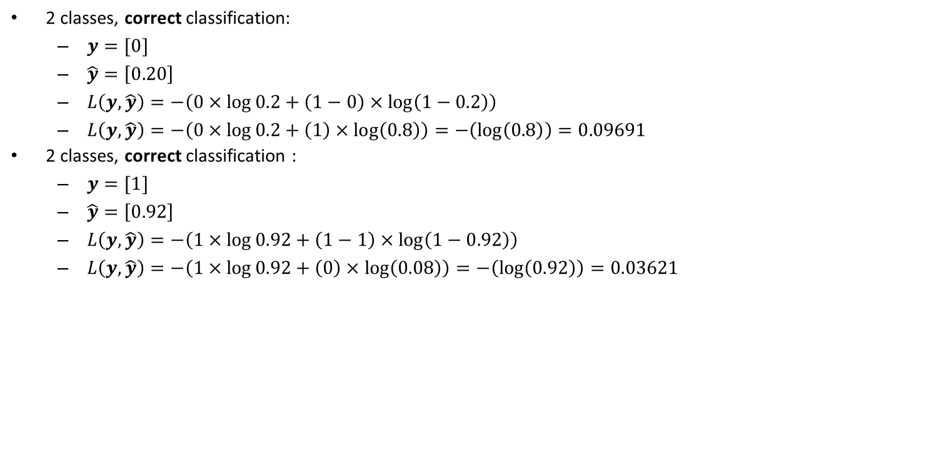
Cross-entropy for M=2
2 classes, correct classification:
$y=[0]$
$\hat{y}=\left[0.20\right]$
$L\left(y, \hat{y}\right)=−\left(0×\log{0.2}+\left(1−0\right)×\log\left(1−0.2\right)\right)$
$L\left(y, \hat{y}\right)=−\left(0×\log{0.2}+\left(1\right)×\log\left(0.8\right)\right)=−\left(\log\left(0.8\right)\right)=0.09691$
2 classes, correct classification :
$y=[1]$
$\hat{y}=\left[0.92\right]$
$L\left(y, \hat{y}\right)=−\left(1×\log{0.92}+\left(1−1\right)×\log\left(1−0.92\right)\right)$
$L\left(y, \hat{y}\right)=−\left(1×\log{0.92}+\left(0\right)×\log\left(0.08\right)\right)=−\left(\log\left(0.92\right)\right)=0.03621$
2 classes, classificação incorreta:
$y=[0]$
$\hat{y}=\left[0,65\right]$
$L\left(y, \hat{y}\right)=−\left(0×\log{0,65}+\left(1−0\right)×\log\left(1−0,65\right)\right)$
$L\left(y, \hat{y}\right)=−\left(0×\log{0,65}+\left(1\right)×\log\left(0,35\right)\right)=−\left(\log\left(0,35\right)\right)=0,45593$
1.0
1.0
θ = 0.5
θ = 0.0
–1.0
–1.0
Logistic
Hyperbolic tangent
$$\hat{y}$$
$$L$$
$$L\left(y, \hat{y}\right)$$
...
$$y$$

Slide 53
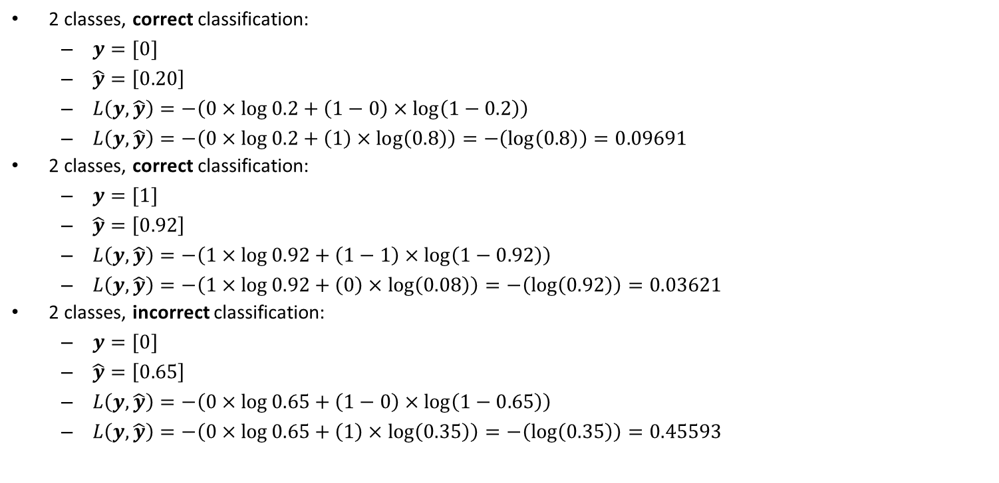
Cross-entropy for M=2
2 classes, correct classification:
$y=[0]$
$\hat{y}=\left[0.20\right]$
$L\left(y, \hat{y}\right)=−\left(0×\log{0.2}+\left(1−0\right)×\log\left(1−0.2\right)\right)$
$L\left(y, \hat{y}\right)=−\left(0×\log{0.2}+\left(1\right)×\log\left(0.8\right)\right)=−\left(\log\left(0.8\right)\right)=0.09691$
2 classes, correct classification:
$y=[1]$
$\hat{y}=\left[0.92\right]$
$L\left(y, \hat{y}\right)=−\left(1×\log{0.92}+\left(1−1\right)×\log\left(1−0.92\right)\right)$
$L\left(y, \hat{y}\right)=−\left(1×\log{0.92}+\left(0\right)×\log\left(0.08\right)\right)=−\left(\log\left(0.92\right)\right)=0.03621$
2 classes, incorrect classification:
$y=[0]$
$\hat{y}=\left[0.65\right]$
$L\left(y, \hat{y}\right)=−\left(0×\log{0.65}+\left(1−0\right)×\log\left(1−0.65\right)\right)$
$L\left(y, \hat{y}\right)=−\left(0×\log{0.65}+\left(1\right)×\log\left(0.35\right)\right)=−\left(\log\left(0.35\right)\right)=0.45593$
1.0
1.0
θ = 0.5
θ = 0.0
–1.0
–1.0
Logistic
Hyperbolic tangent
$$\hat{y}$$
$$L$$
$$L\left(y, \hat{y}\right)$$
...
$$y$$

Slide 54
Optimizers

Slide 55
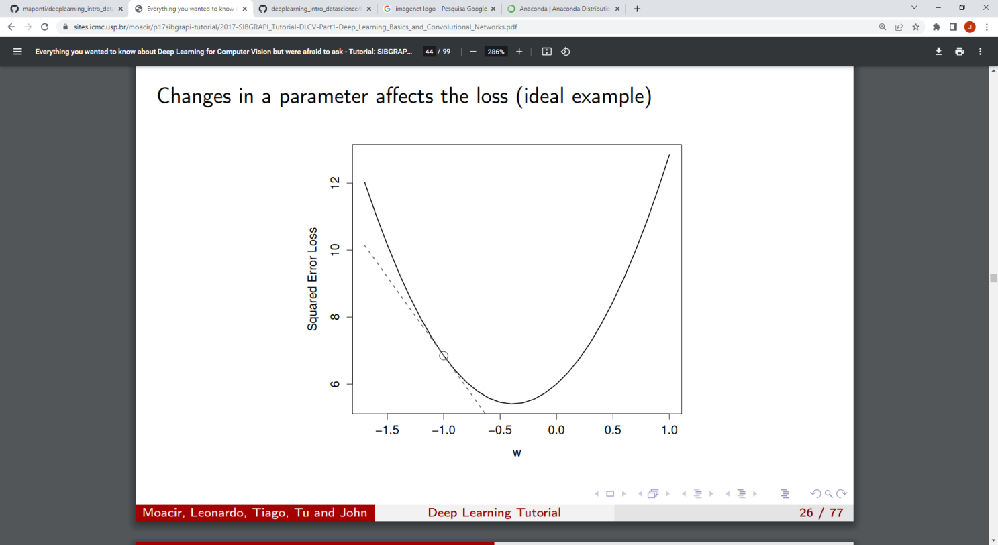
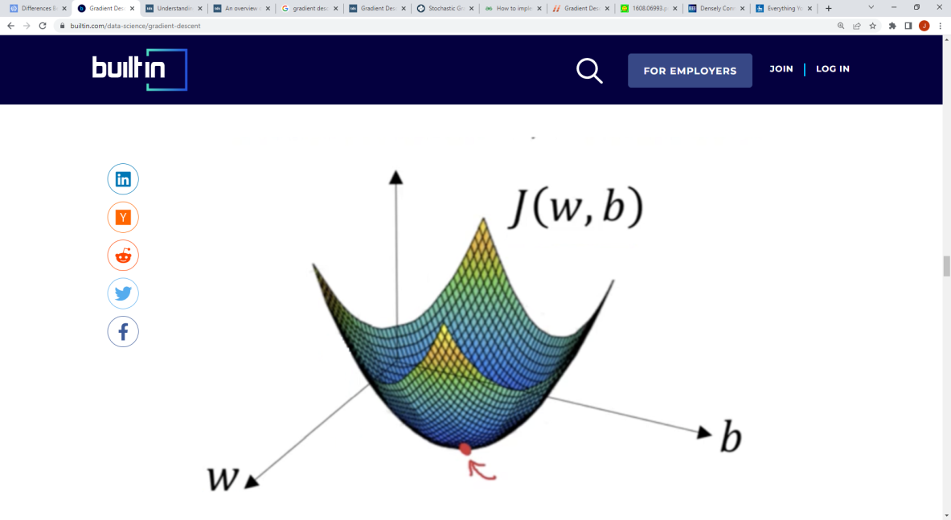
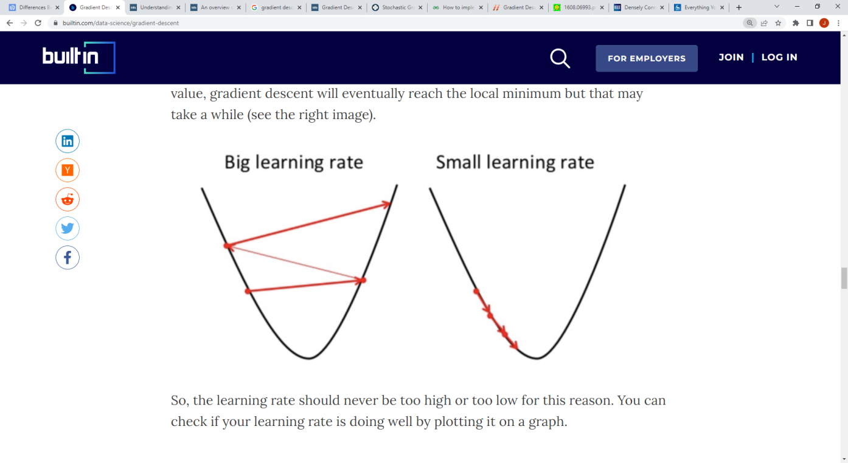
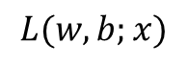
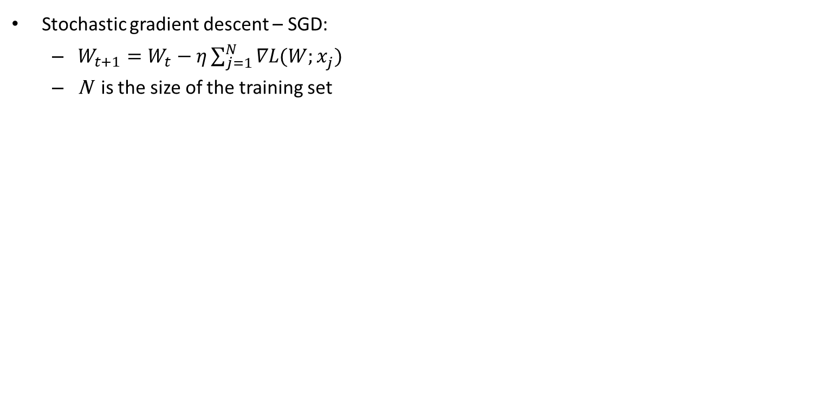
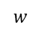
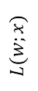
Optimizers
Stochastic gradient descent – SGD:
$W_{t+1}=W_{t}−η\sum_{j=1}^{N}{∇L(W;x_{j}^{})}$
N is the size of the training set
$$L(w,b;x)$$
$$L(w;x)$$
$$w$$
Donges. Gradient Descent in Machine Learning: A Basic Introduction. https://builtin.com/data-science/gradient-descent
Moacir Ponti. http://conteudo.icmc.usp.br/pessoas/moacir/p17sibgrapi-tutorial/

Slide 56
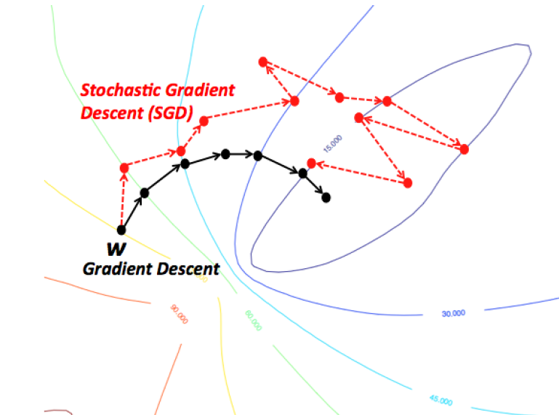
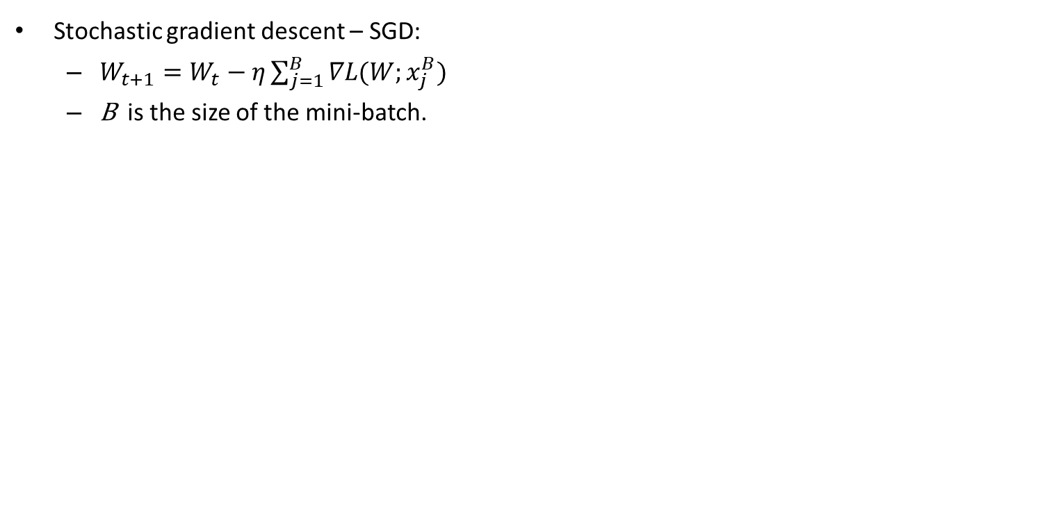
Optimizers
Stochastic gradient descent – SGD:
$W_{t+1}=W_{t}−η\sum_{j=1}^{B}{∇L(W;x_{j}^{B})}$
B is the size of the mini-batch.
https://wikidocs.net/3413

Slide 57
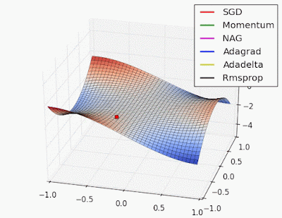
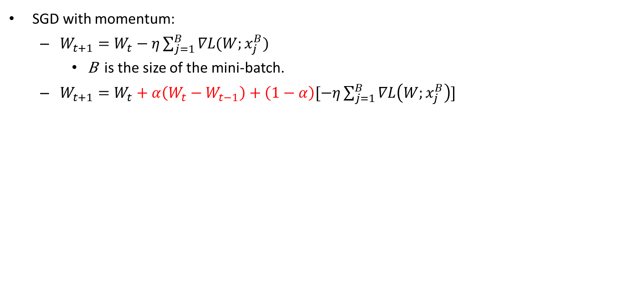
Optimizers
SGD with momentum:
$W_{t+1}=W_{t}−η\sum_{j=1}^{B}{∇L(W;x_{j}^{B})}$
B is the size of the mini-batch.
$W_{t+1}=W_{t}+α\left(W_{t}−W_{t−1}\right)+\left(1−α\right)[−η\sum_{j=1}^{B}{∇L\left(W;x_{j}^{B}\right)}]$
http://www.denizyuret.com/2015/03/alec-radfords-animations-for.html

Slide 58
Optimizers
Other optimizers :
AdaGrad - Adaptive Gradient
AdaDelta - Adaptive learning rate
RMSProp - Root Mean Squared Propagation
Adam - Adaptive moment estimation
...

Slide 59
Architectures

Slide 60
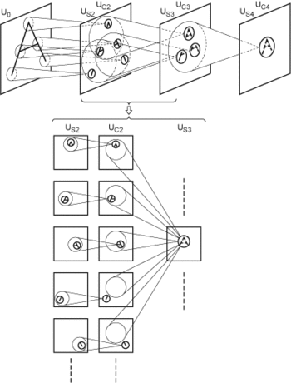

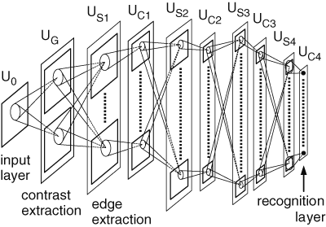
Architectures
Neocognitron (1979)
Kunihiko Fukushima
Fukushima, K. (1980). "Neocognitron: A self-organizing neural network model for a mechanism of pattern recognition unaffected by shift in position". Biological Cybernetics. 36 (4): 193–202.

Slide 61

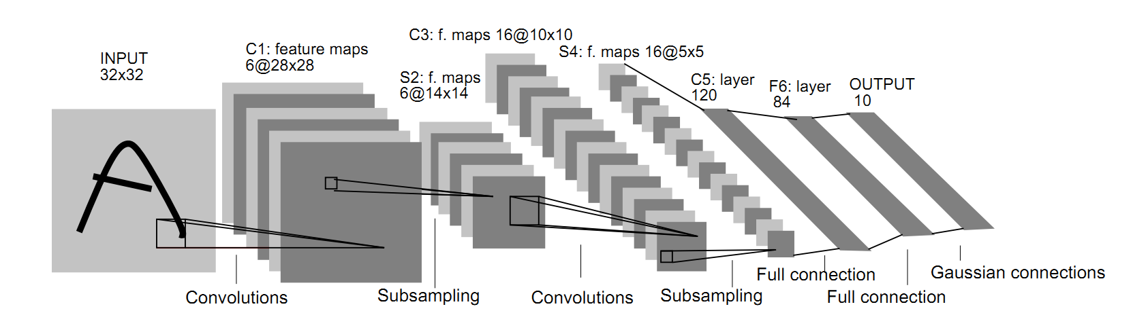
Architectures
LeNet-5 (1998)
Yann LeCun
Lecun, Y. et al. (1998). "Gradient-based learning applied to document recognition". Proceedings of the IEEE. 86 (11): 2278–2324.

Slide 62

Architectures
AlexNet (2012)
Krizhevsky, Sutskever e Hinton. ImageNet Classification with Deep Convolutional Neural Networks. NeuripIPS 2012

Slide 63
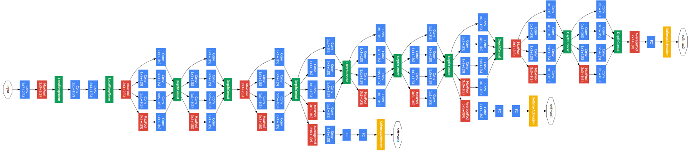
Architectures
Inception (GoogLeNet) (2015)
Szegedy, Christian (2015). "Going deeper with convolutions". CVPR2015.

Slide 64
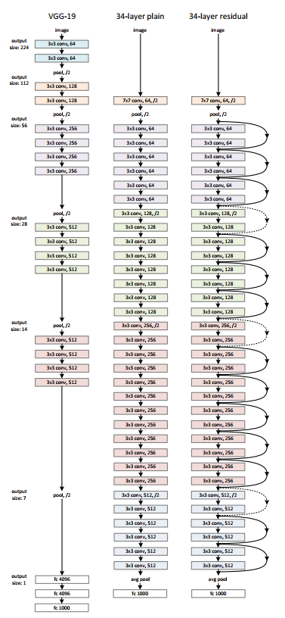
Architectures
VGG (2014) and ResNet (2015)
Simonyan e Zisserman. Very Deep Convolutional Networks for Large-Scale Image Recognition. 2014
He et al. Deep Residual Learning for Image Recognition. 2015.

Slide 65
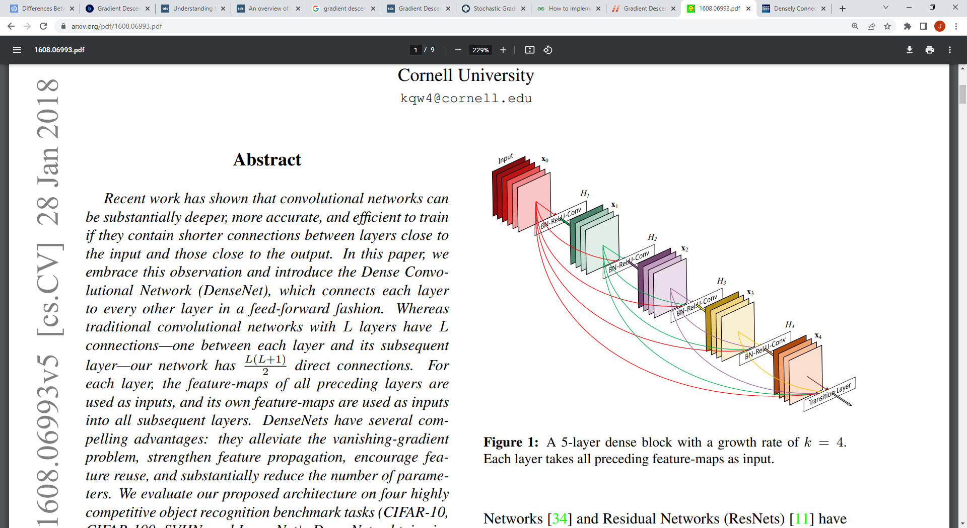

Architectures
DenseNet (2017)
Ponti et al. Everything You Wanted to Know about Deep Learning for Computer Vision but Were Afraid to Ask. Sibgrapi 2017.
Huang et al. Densely Connected Convolutional Networks. CVPR 2017.

Slide 66

Architectures
ImageNet Large Scale Visual Recognition Challenge
https://image-net.org/challenges/LSVRC/
https://semiengineering.com/new-vision-technologies-for-real-world-applications/

Slide 67
Libraries and development

Slide 68


Libraries and development
Training CNNs has a high computational cost.
It is recommended that training be performed on GPUs.
Google Colab provides access to GPUs (with some restrictions).

Slide 69


Libraries and development
Top libraries for Deep Learning and Convolutional Neural Networks
PyTorch
https://pytorch.org/
Tensorflow
https://www.tensorflow.org/

Slide 70


Libraries and development
Anaconda Distribution:
Python distribution with support for major libraries
https://www.anaconda.com/products/distribution
Google Colab:
Cloud runtime environment with GPUs
https://colab.research.google.com

Slide 71
Image datasets

Slide 72

Image datasets
MNIST:
http://yann.lecun.com/exdb/mnist/
60,000 training images
10,000 testing images
28 x 28 pixels
Gray level images

Slide 73

Image datasets
Cats vs. Dogs:
https://www.kaggle.com/c/dogs-vs-cats
25,000 training images
12,500 test images
2 classes
Various sizes
RGB

Slide 74

Image datasets
CIFAR10:
https://www.cs.toronto.edu/~kriz/cifar.html
50,000 training images
10,000 testing images
10 classes
32 x 32 pixels
RGB

Slide 75

Image datasets
ImageNet:
https://www.image-net.org/
~1,000,000 images
1,000 classes
RGB

Slide 76
Bibliography
Ponti et al. Everything You Wanted to Know about Deep Learning for Computer Vision but Were Afraid to Ask. Sibgrapi 2017.
Moacir Ponti (ICMC-USP). Material para o minicurso Deep Learning
https://github.com/maponti/deeplearning_intro_datascience
Learn TensorFlow and deep learning, without a Ph.D.
https://cloud.google.com/blog/products/gcp/learn-tensorflow-and-deep-learning-without-a-phd
CS231n: Convolutional Neural Networks for Visual Recognition
http://cs231n.github.io/
Goodfellow, Bengio e Courville. Deep Learning. MIT Press, 2016
https://www.deeplearningbook.org/
The MathWorks, Inc. What is a Convolutional Neural Network? 3 things you need to know.
https://www.mathworks.com/discovery/convolutional-neural-network-matlab.html

Slide 77
Bibliography
Fukushima, K. (1980). Neocognitron: A self-organizing neural network model for a mechanism of pattern recognition unaffected by shift in position. Biological Cybernetics. 36 (4): 193–202.
10.1007/bf00344251
Lecun, Y. et al. (1998). Gradient-based learning applied to document recognition. Proceedings of the IEEE. 86 (11): 2278–2324.
10.1109/5.726791
Krizhevsky, Sutskever e Hinton. ImageNet Classification with Deep Convolutional Neural Networks. NeuripIPS 2012.
Szegedy, Christian (2015). Going deeper with convolutions. CVPR2015.
Simonyan e Zisserman. Very Deep Convolutional Networks for Large-Scale Image Recognition. 2014.
He et al. Deep Residual Learning for Image Recognition. 2015.
Huang et al. Densely Connected Convolutional Networks. CVPR 2017.
Rodrigues, L. F.; Naldi M. C., Mari, J. F. Comparing convolutional neural networks and preprocessing techniques for HEp-2 cell classification in immunofluorescence images. Computers in Biology and Medicine, 2019.
https://doi.org/10.1016/j.compbiomed.2019.103542

Slide 78
THE END

